Slide 1
Welcome to AP Art History
What is art history?

Slide 2
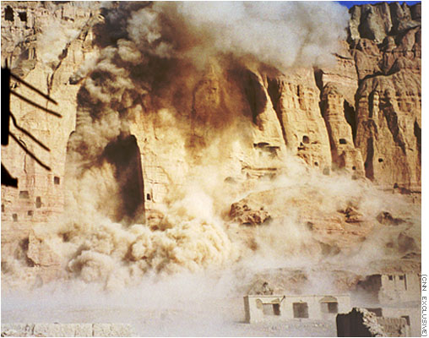
Buddhas of Bamiyan Afghanistan

Slide 3
Monuments men

Slide 4
Sadam Hussein statue, Iraq

Slide 5
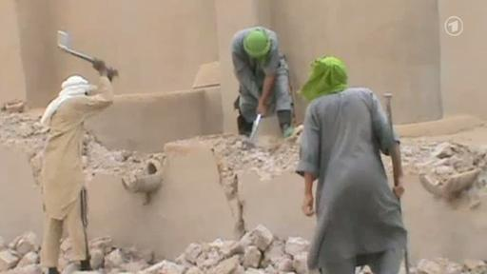
Sufi Muslim Shrines, timbuktu , west africa

Slide 6
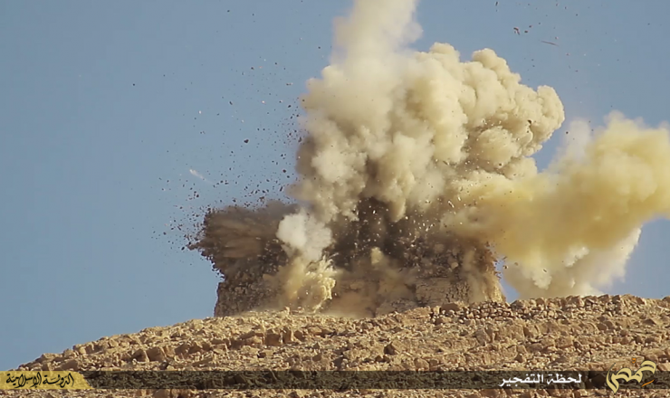
Palmyra, syria

Slide 7
Benin sculpture, Nigeria

Slide 8
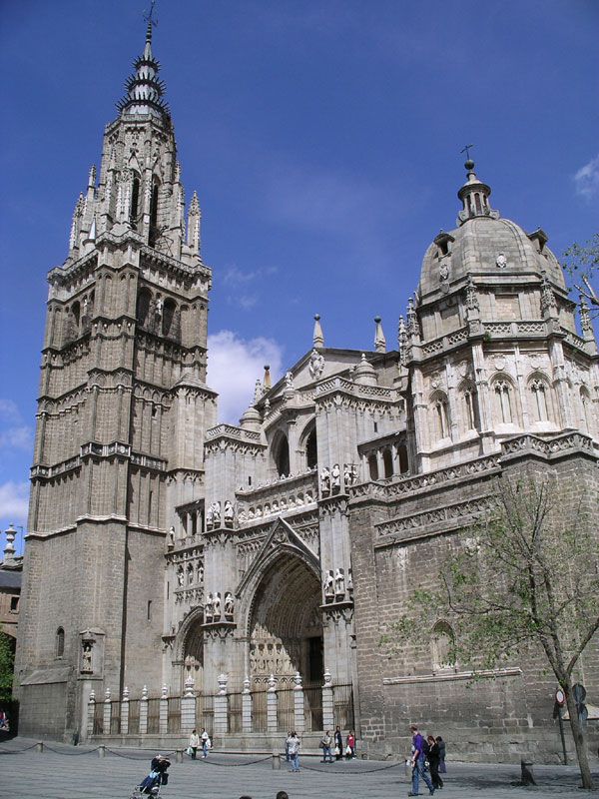
Cathedral Mosque of toledo

Slide 9
What do you think is the value of art and artifacts?
To help understand human nature.
To help understand culture.
To help understand values at a particular time and place.
To better understand who we are, what we dream, what we hope.
Hypothetical question:
Would there be art in a perfect world?

Slide 10
Describe, Analyze, contextualize, Interpret
Form
Function
Content
Context

Slide 11
Big Ideas
Artists manipulate materials and ideas to create an aesthetic object, act or event.
Art making is shaped by tradition and change.
Interpretations of art are variable

Slide 12
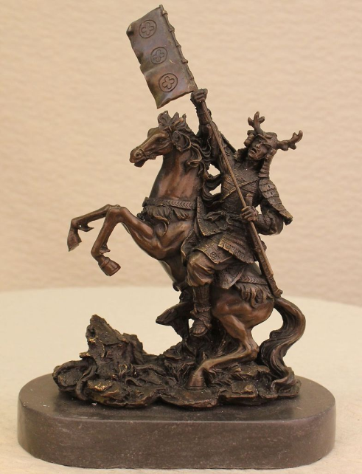
How can art history be organized?
Chronologically
Geographically
By function
By form
By material and technique
Thematically

Slide 13
A Process of Inquiry
What is it?
What does it look like?
What is it made of?
Who made it?
Who commissioned it?
When and where was it made?
What was happened in the artist’s world when it was made?
Who used it? How was it used?
Who were its audiences? How did they respond to it?
Is it long lasting or ephemeral?
What does it resemble?
What does it mean?
How is it distinctive?
Who and what influenced the artist?
Who and what did the work influence?
Why and how do we know (to all of the above questions)

Slide 14
Big themes
The Natural World
The Human Body
Knowledge and Belief
Individual and Society
Converging Cultures
Great Hall of the Bulls, Lascaux, France. Paleolithic Europe. 15,000-13,000BCE
Rock Painting

