Slide 1
The Power of Public Art as a model for teaching
AENJ Conference 2011
Kate Greenberg

Slide 2
The Power of teaching Public Art
The perfect venue for teaching everything you want to teach
Every Aesthetic decision is laden with meaning
Models the best type of learning: experiential, cooperative, public and involves problem solving.
Gets student art into the public domain and raises awareness in school and in the larger community
Notes:
I wanted to share a couple of projects my students have done over the past couple of years and what I am most interested in sharing is the way these projects bring to the forefront ALL the lessons I want to teach. I also think these projects model the best type of learning- experiential and real.

Slide 3
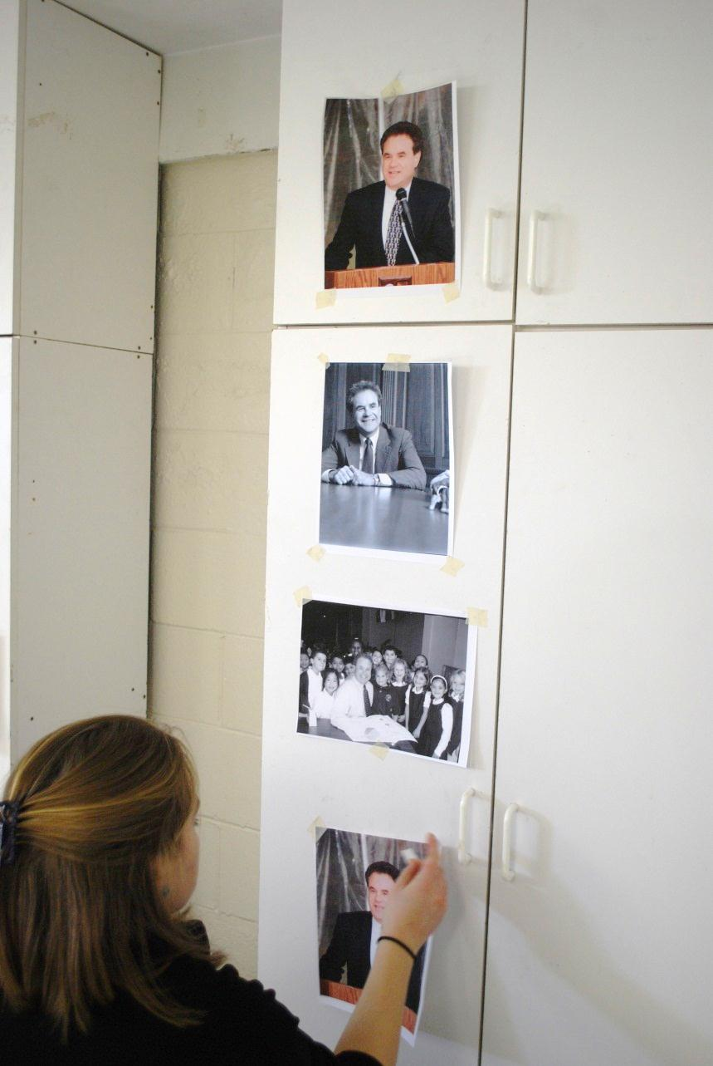
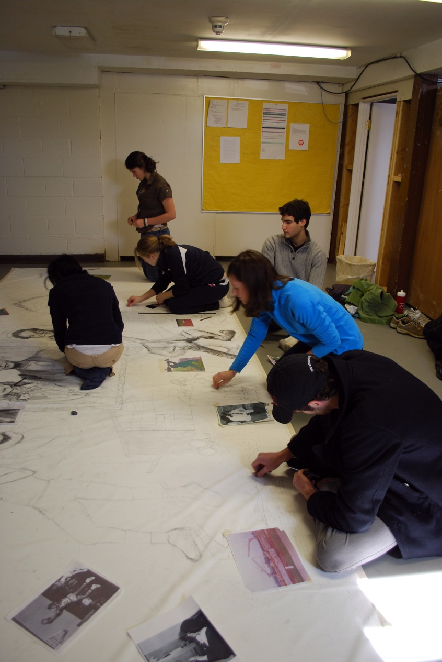
Research

Slide 4
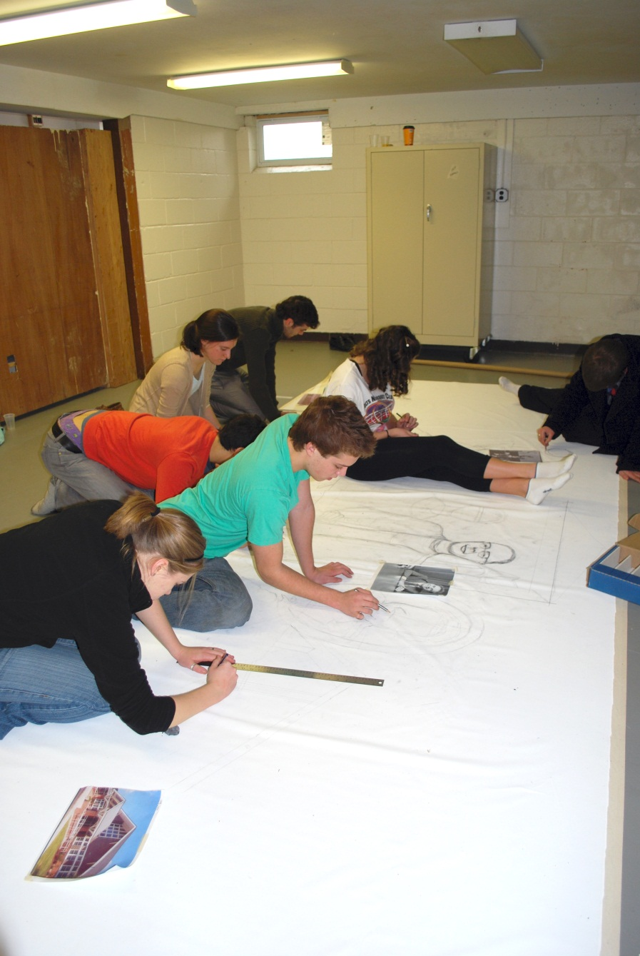
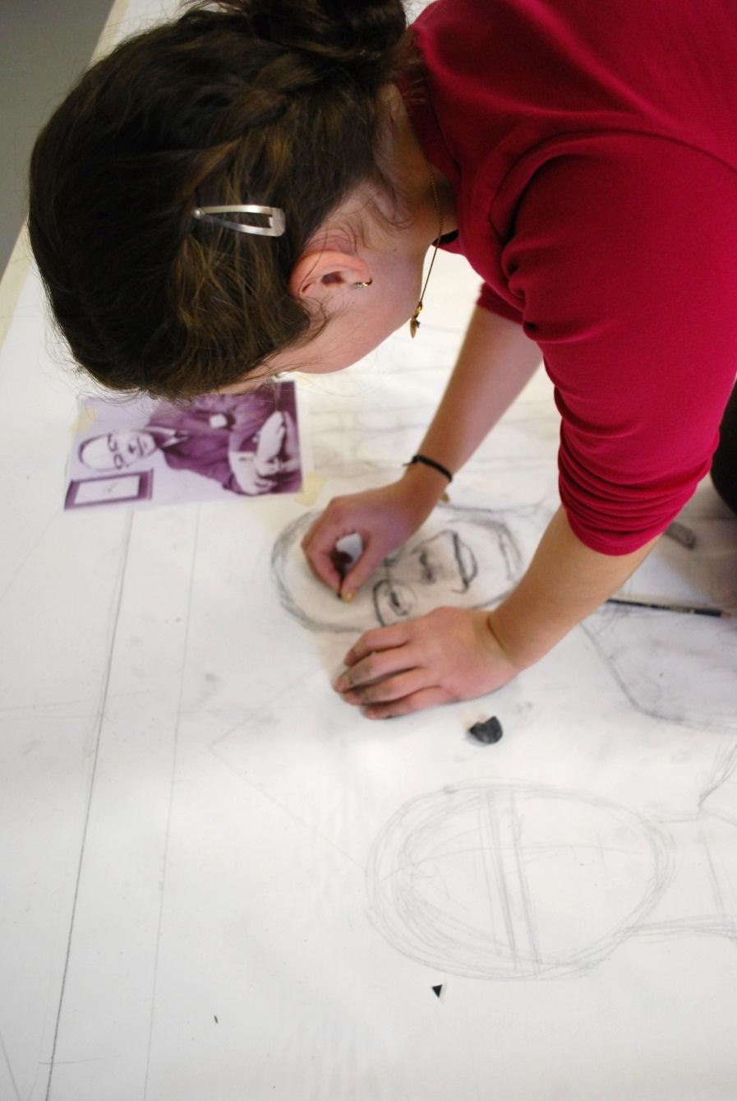
Composition and 20 students
Notes:
Open space where students could come and go and had to be able to make decisions. Rules of composition and scale had to be established right at the start so each student could work when they had time.

Slide 5
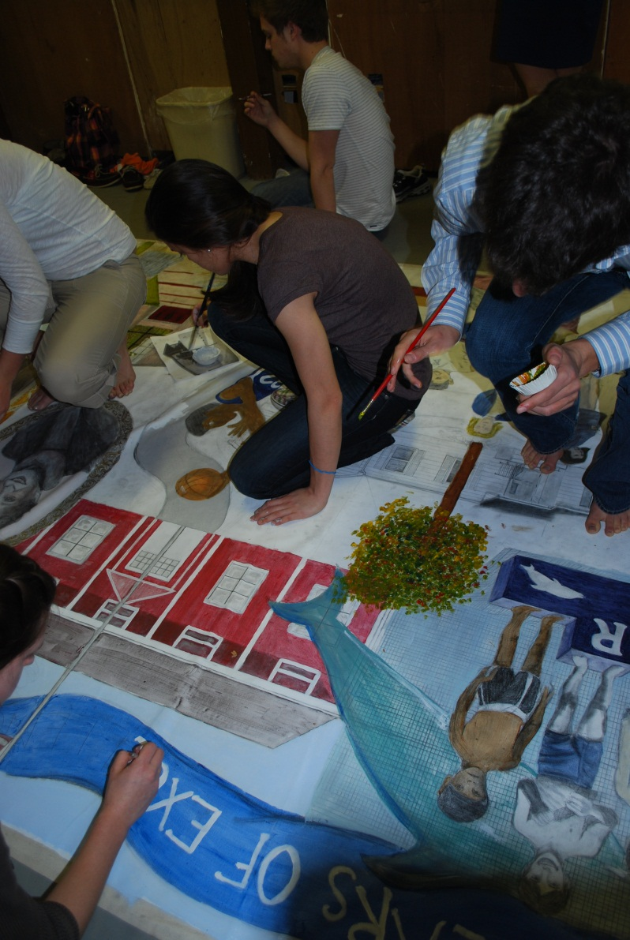
Collective rules of composition
Collaborative education is the most powerful and best represents the world of lifelong learning and the workplace.
Notes:
Overlapping to avoid awkward negative space
Variation in size, keeping in mind the message size sends
Carrying a color or colors across the entire composition for unity
Carrying an element (banner across top) across the entire composition

Slide 6
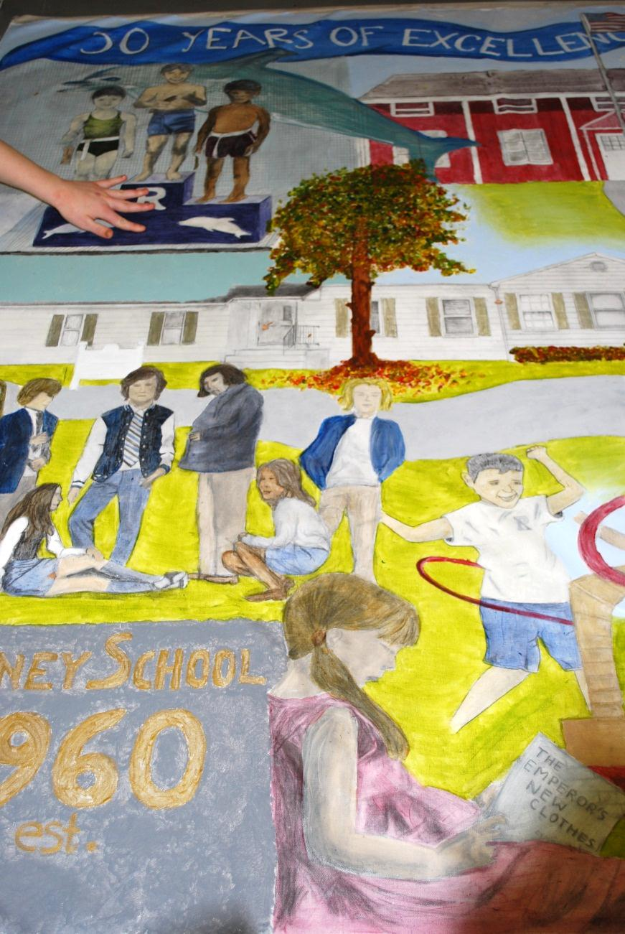
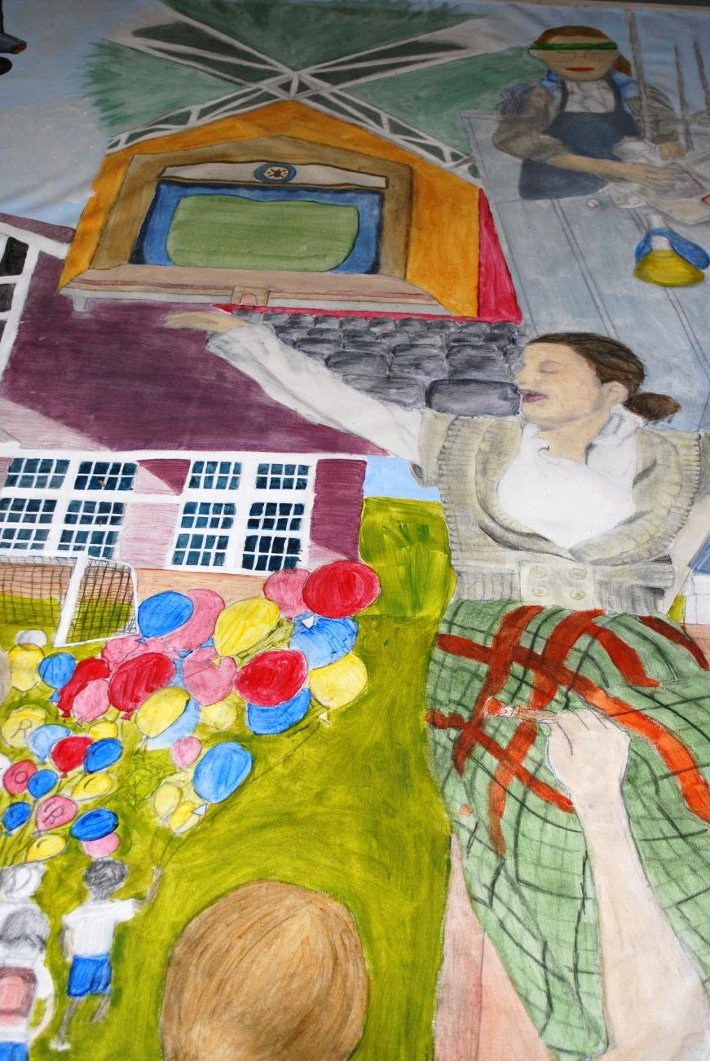
Where in the mural should it go?
1960 2010
Notes:
Complex compositions are the result of basic compositional rules established by he group and constant discussion

Slide 7
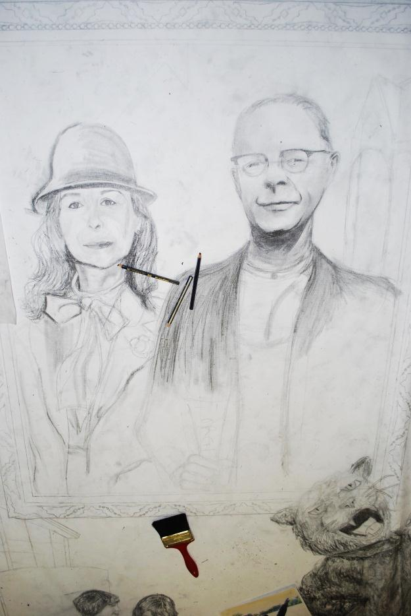
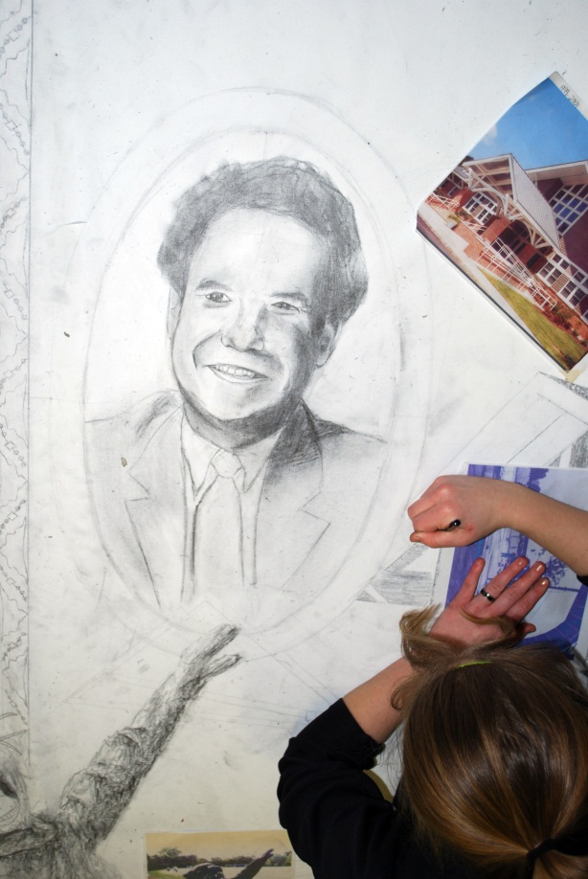
The message of scale

Slide 8
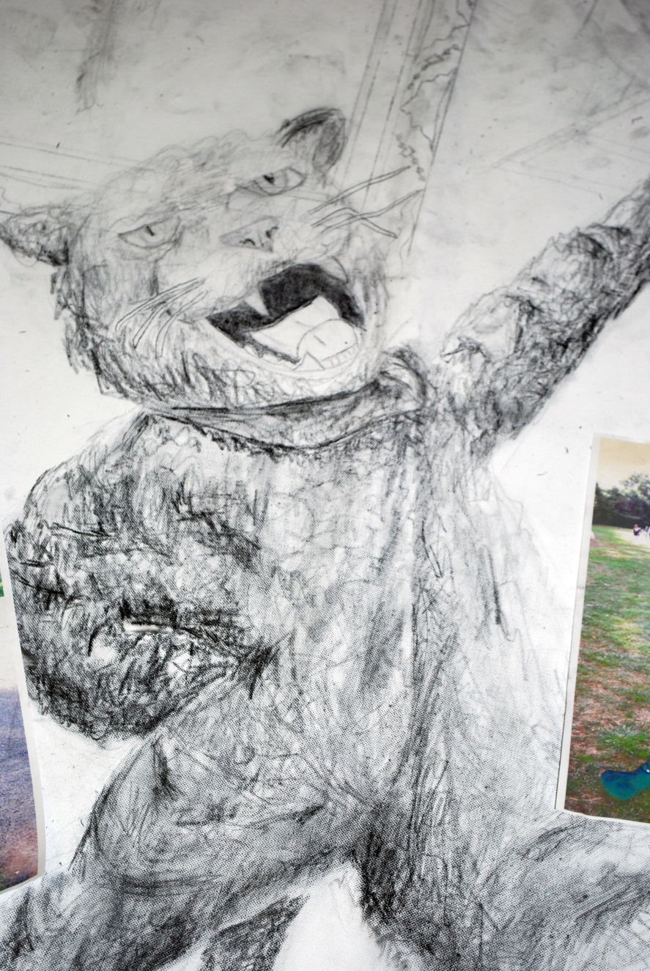
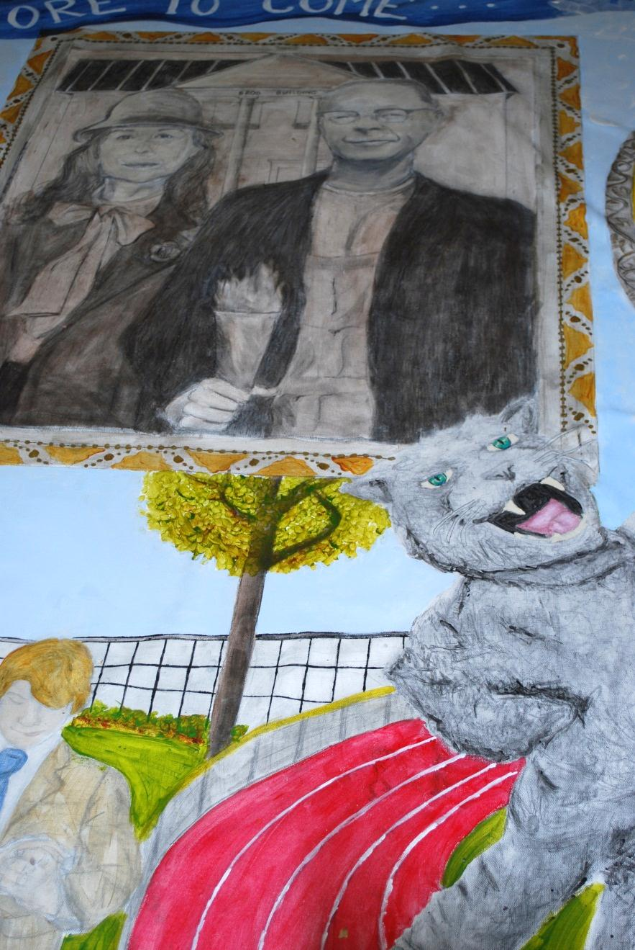
Grisaille and later color

Slide 9
The message of color
Referencing American Gothic

Slide 10
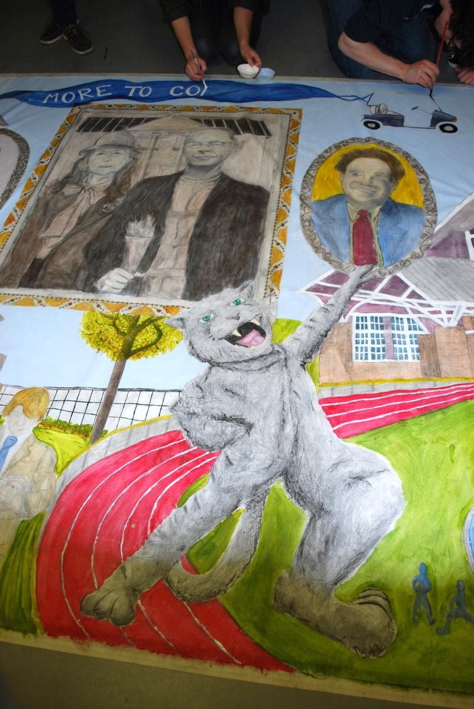
Color as an element of unity

Slide 11
Shading with Grisaille

Slide 12
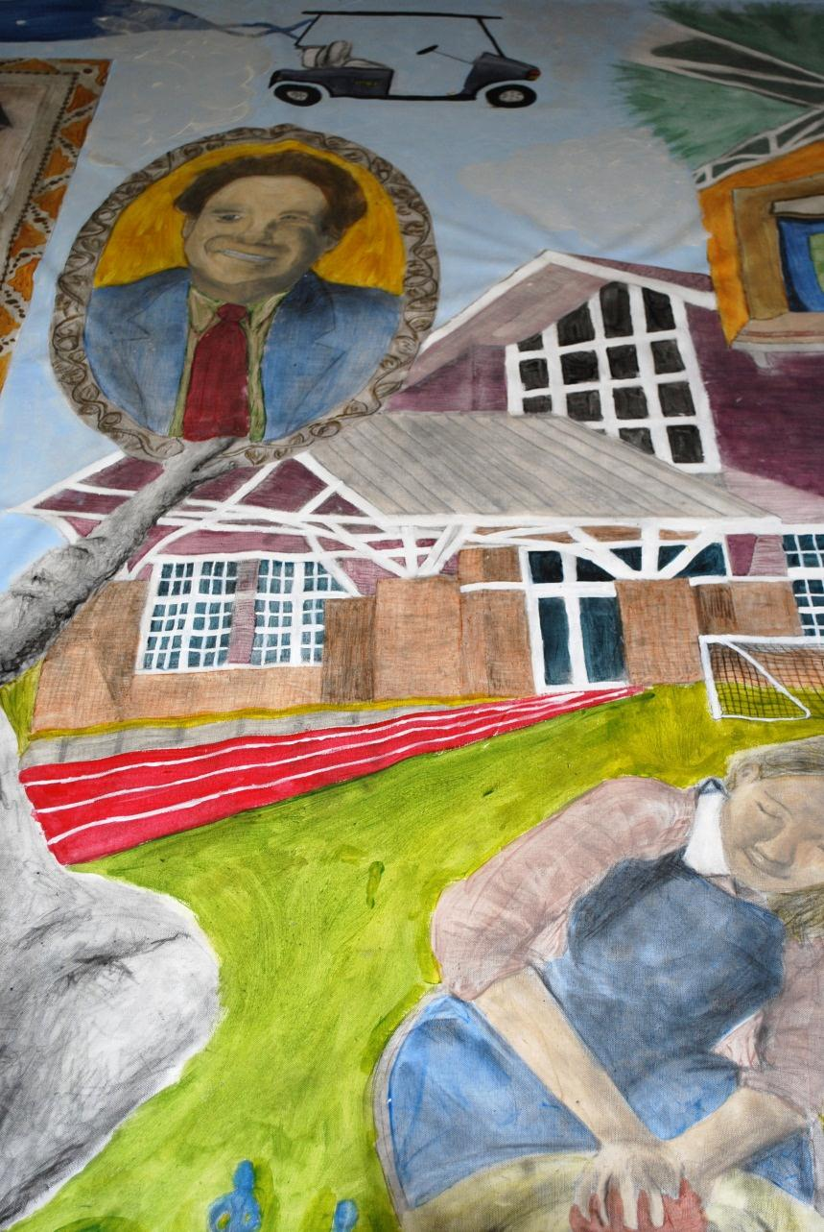
Final touches to bring it all together

Slide 13
The studio as a model for all education
Sir Ken Robinson says schools kill creativity, 2006
Sir Ken Robinson: Bring on the learning revolution!, 2011
Geoff Mulgan: A short intro to the Studio School, 2011

Slide 14
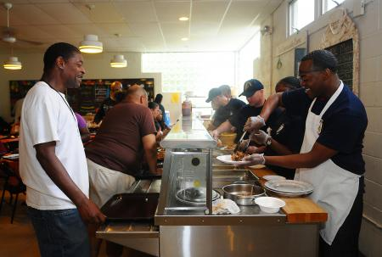
Lunch Break Soup Kitchen
Food bank, soup kitchen, clothing distribution

Slide 15
Client Requests
Mural Must include:
1. Place for daily menu
2. Place for acknowledging birthdays (could be many at one time)
3. Name of soup kitchen
4. Place for inspirational quote
5. A bounty of foods (fresh fruits, vegetables, deserts, cooked foods (pies, turkey etc.)
6. Easy to read
7. Appetizing and appealing to look at

Slide 16
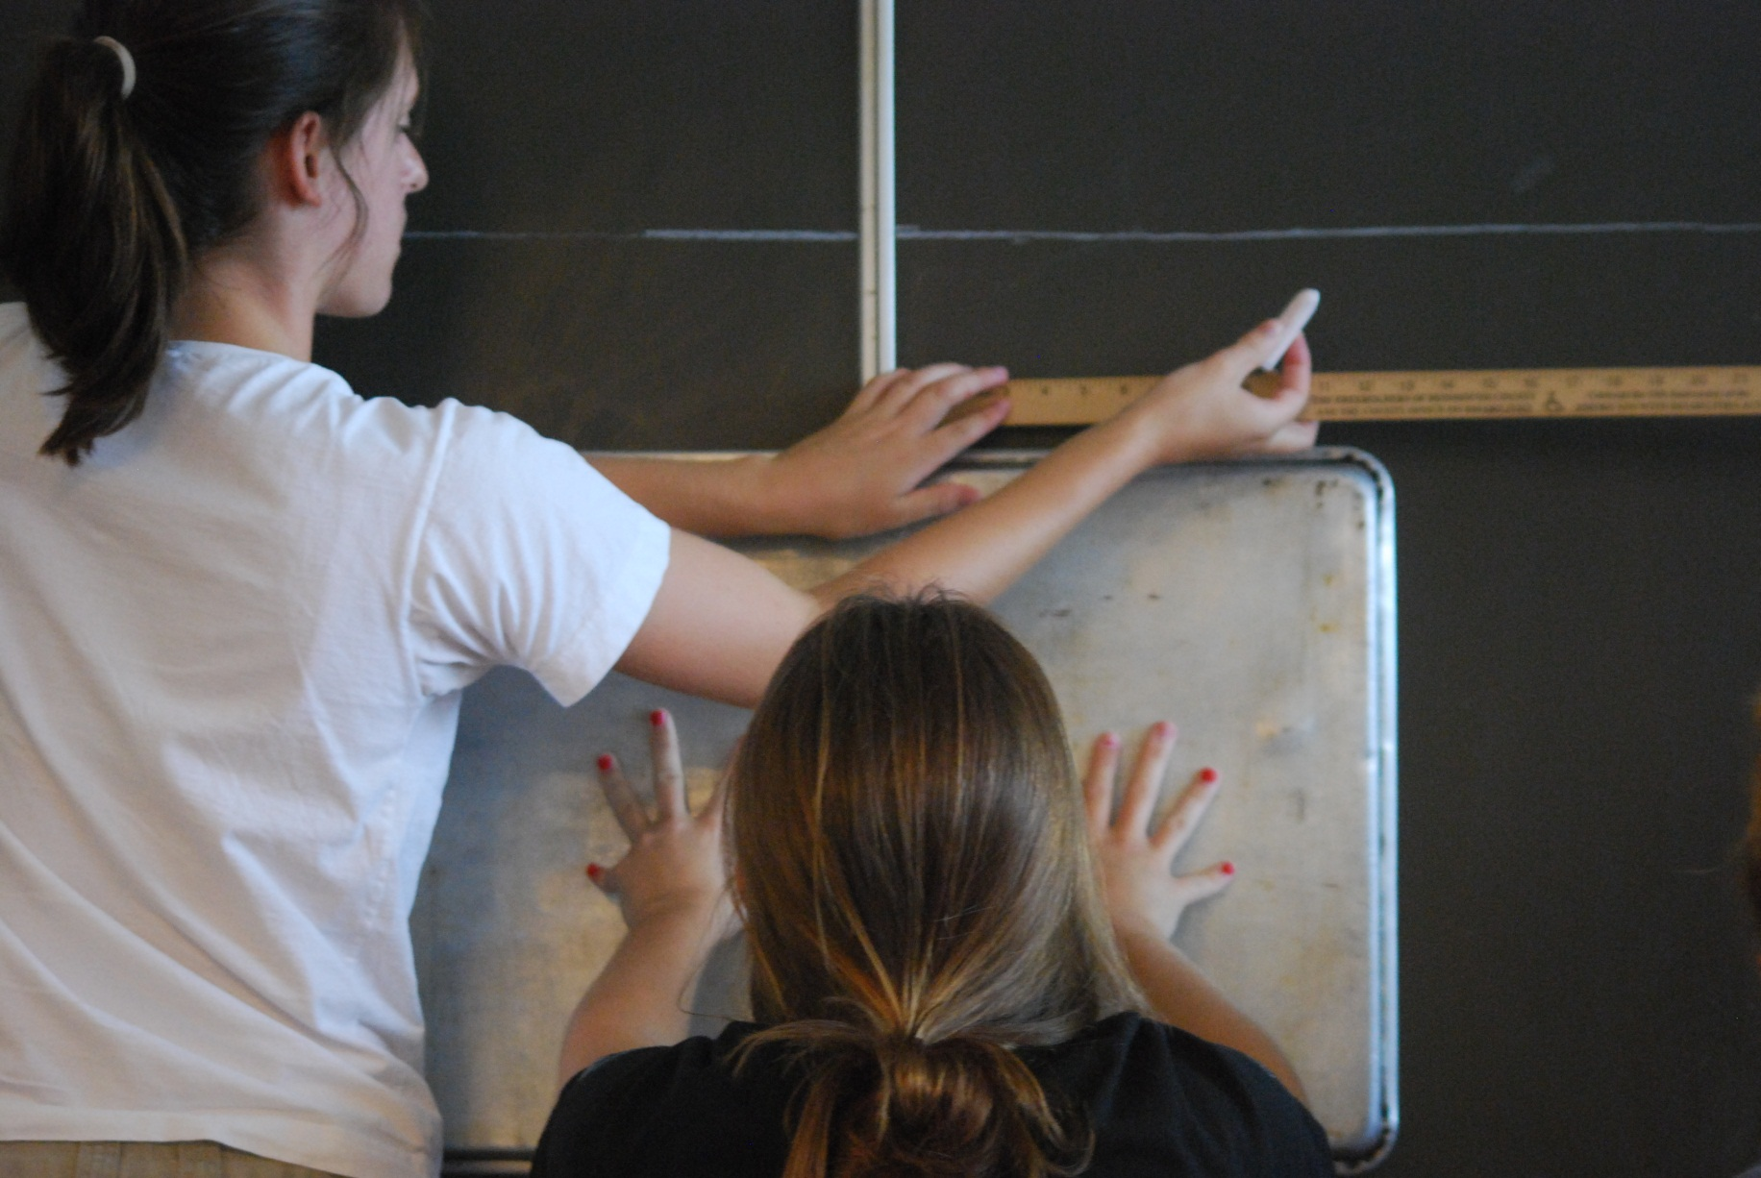
Prioritizing

Slide 17
Organizing the composition

Slide 18
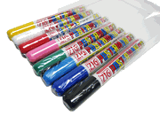
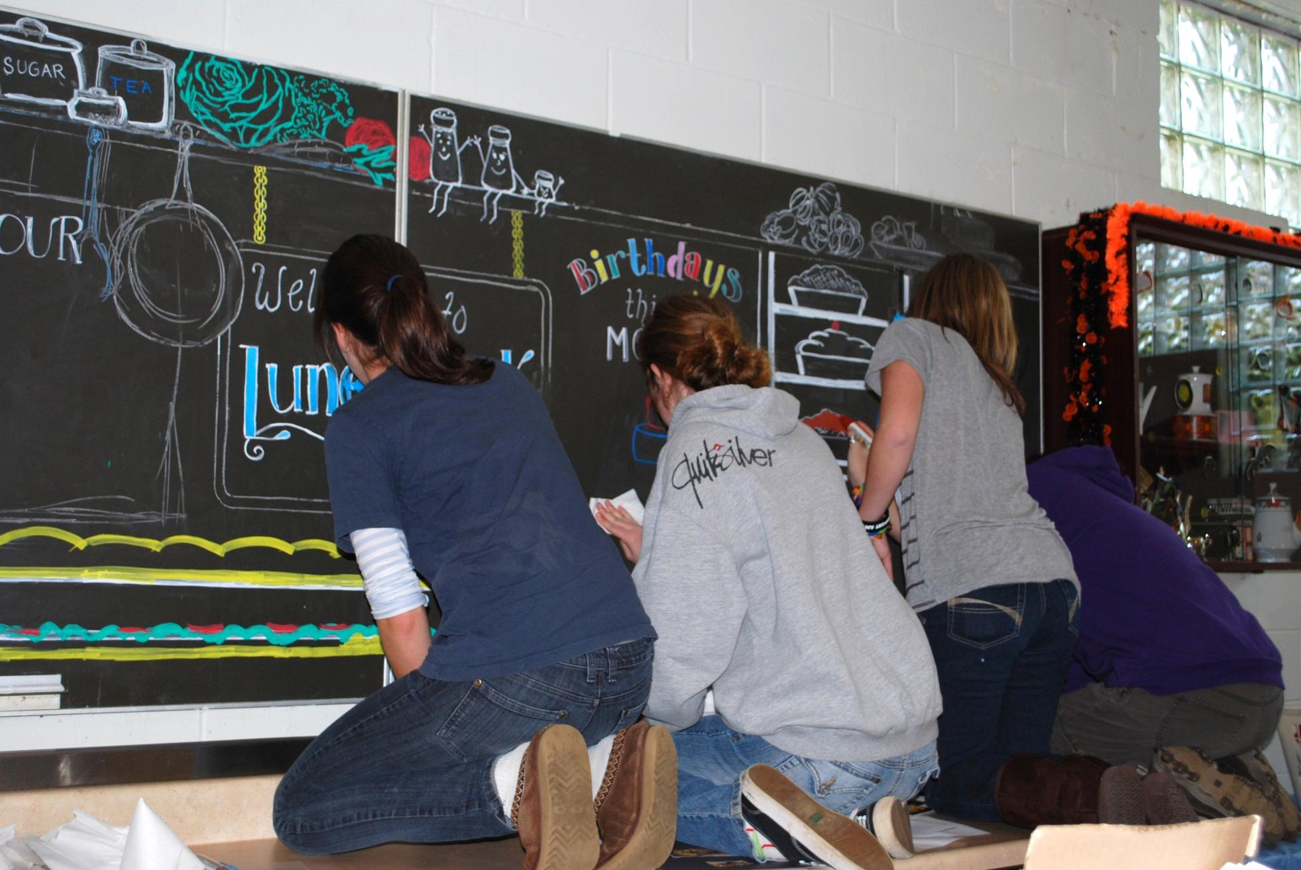
Zip Posterman Markers

Slide 19
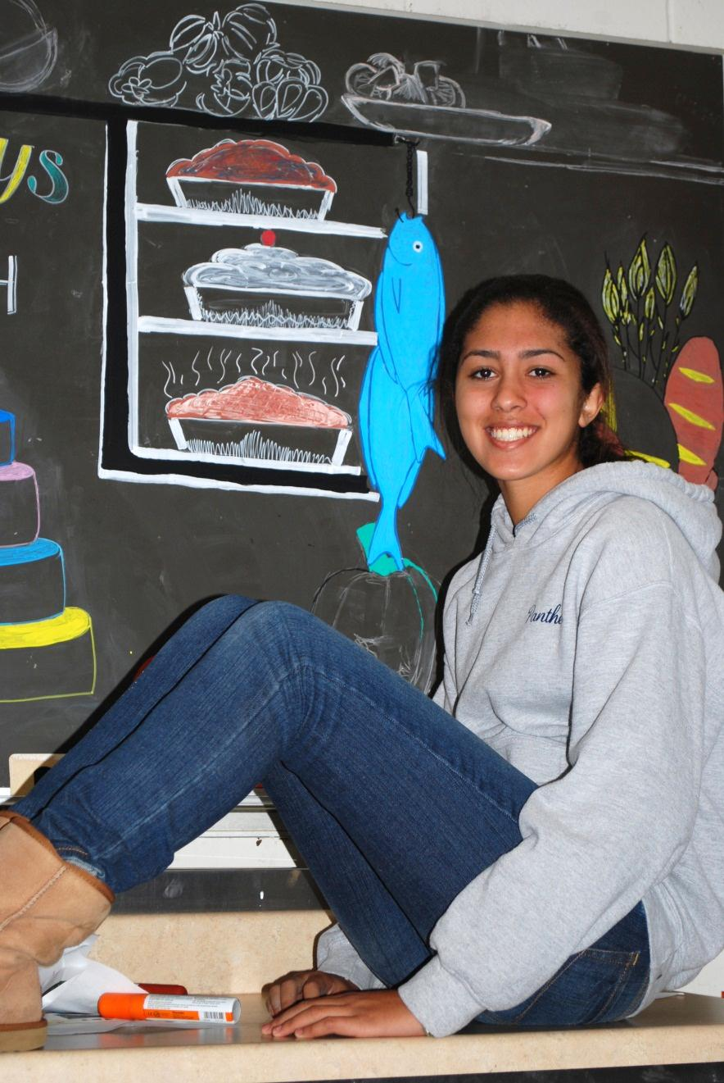
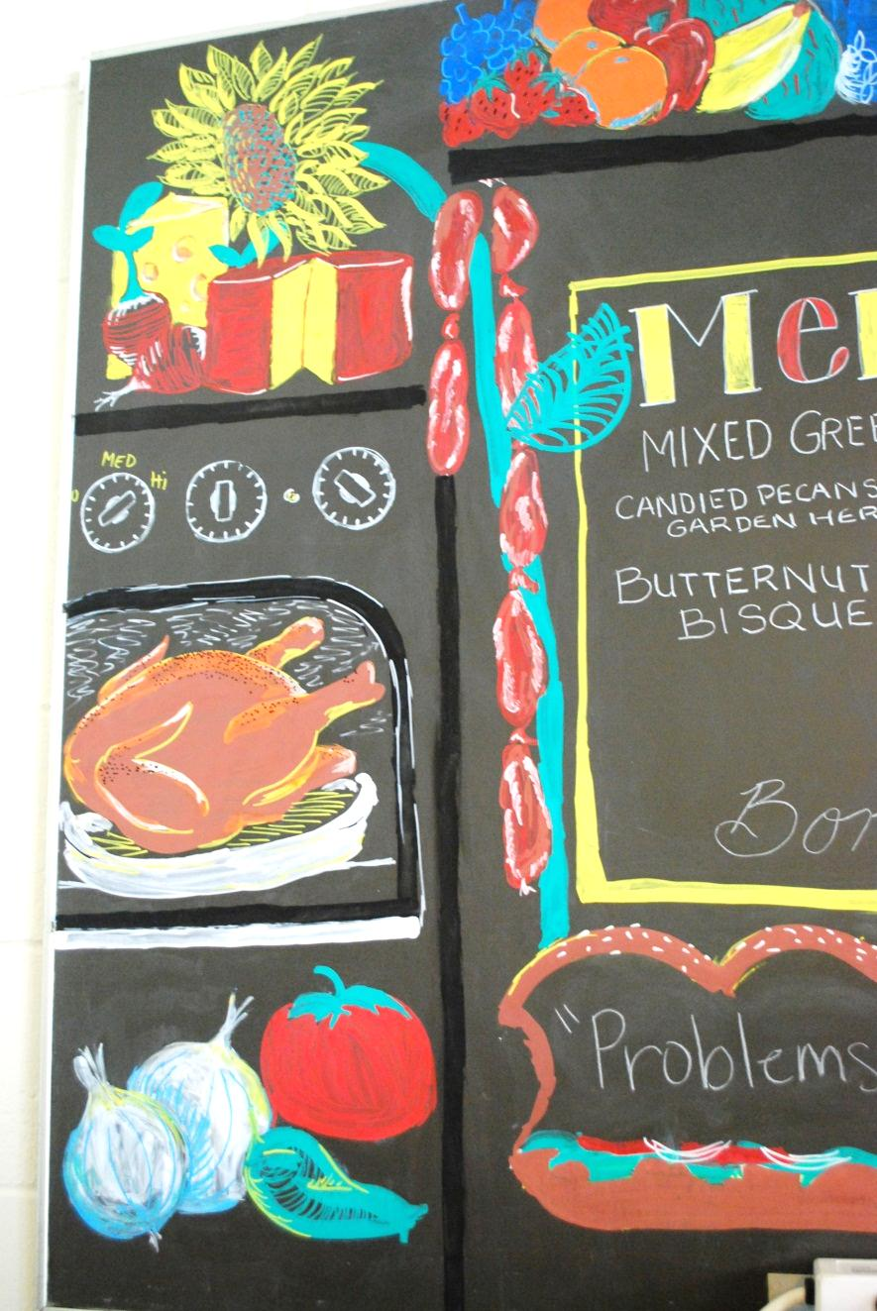
Borders and Order

Slide 20
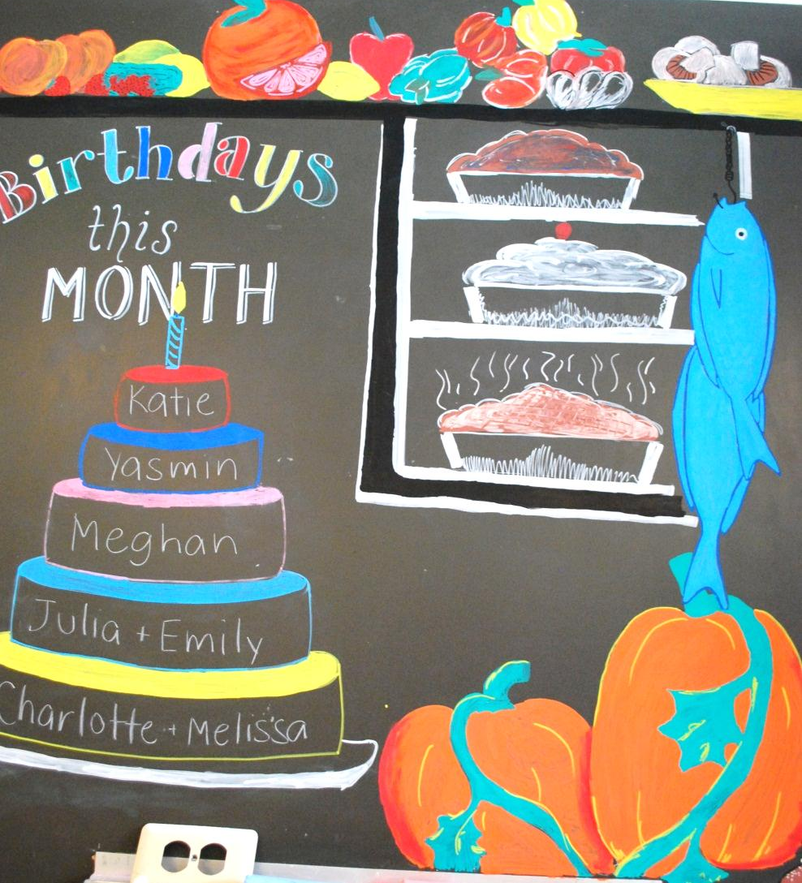
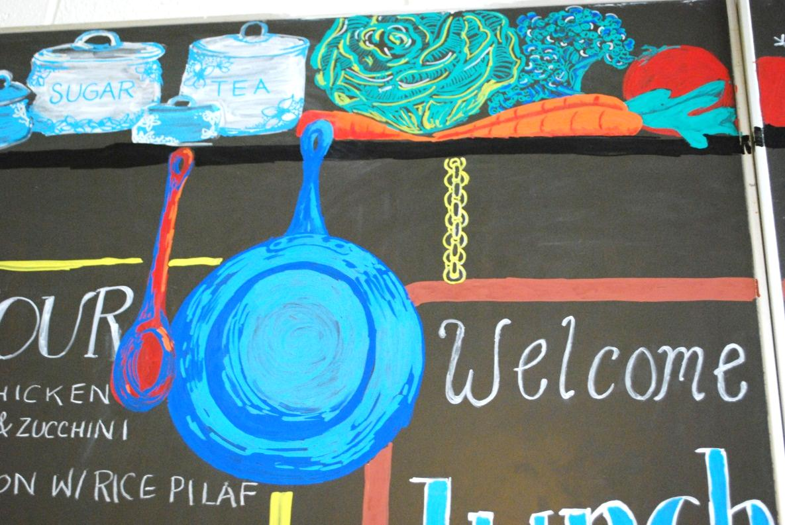
Details

Slide 21
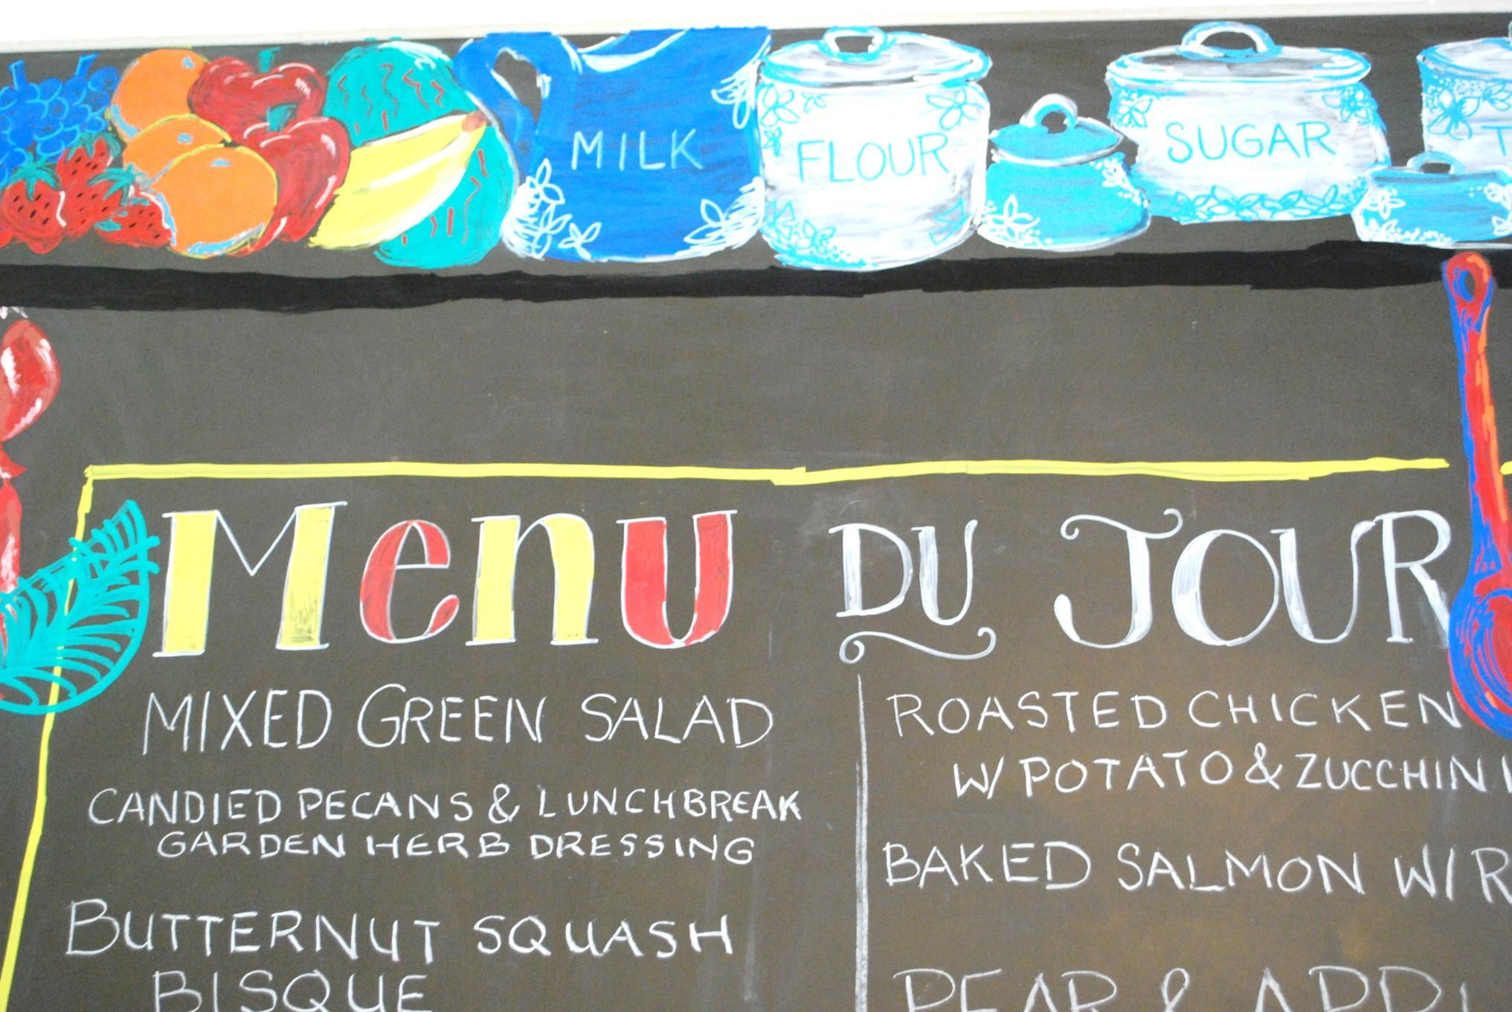
Menu of the Day

Slide 22
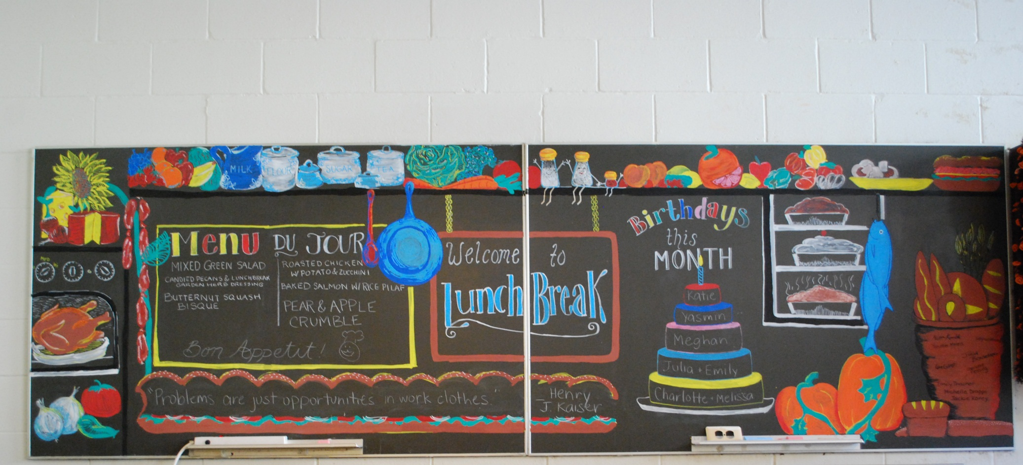
Finished Menu Board
Happy Clients

Slide 23
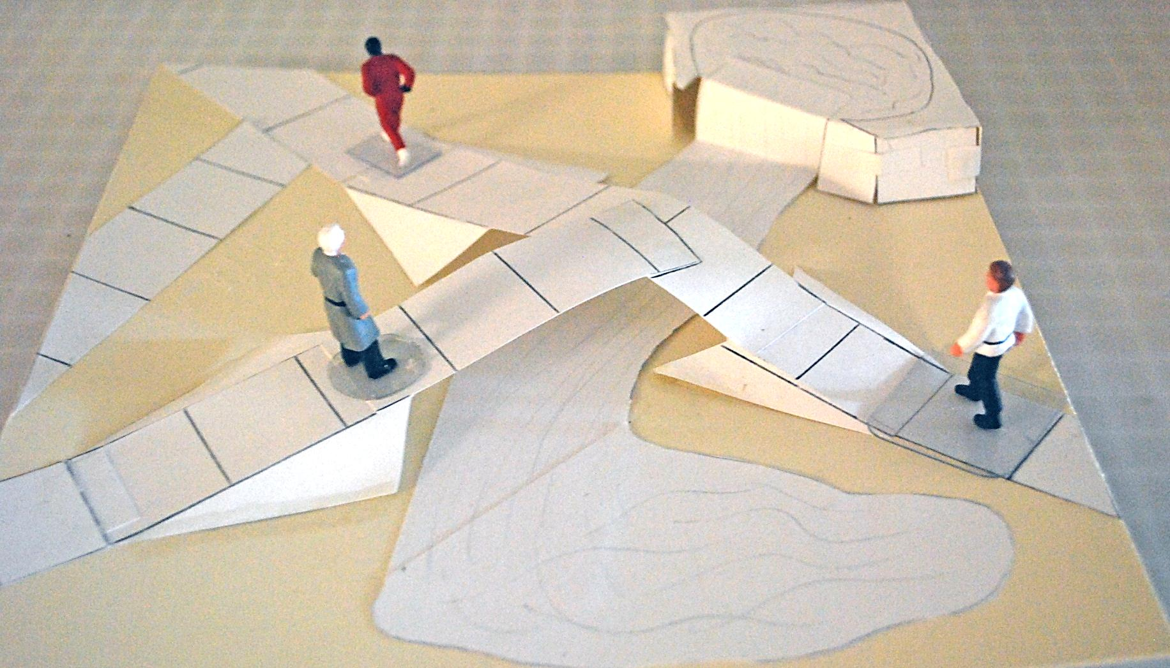
Design for Public Space

Slide 24
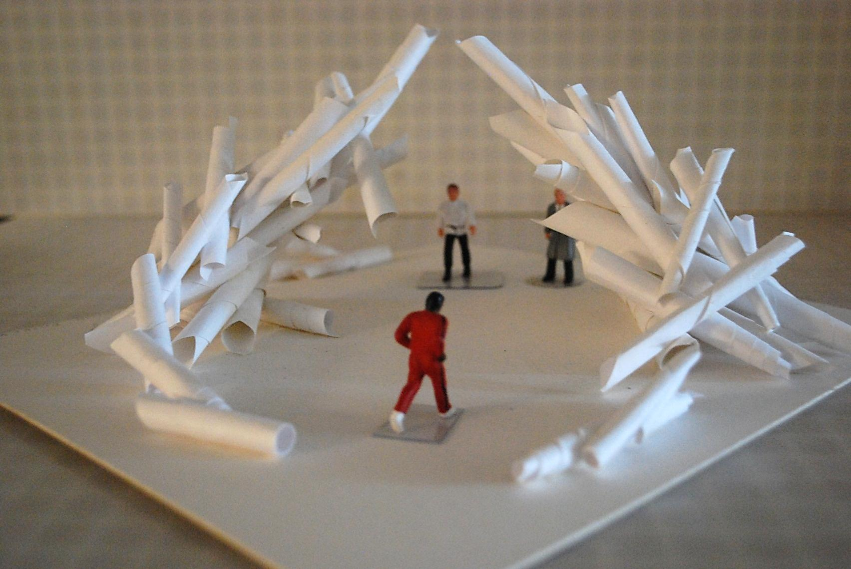

Slide 25
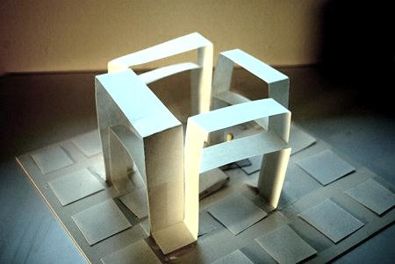

Slide 26
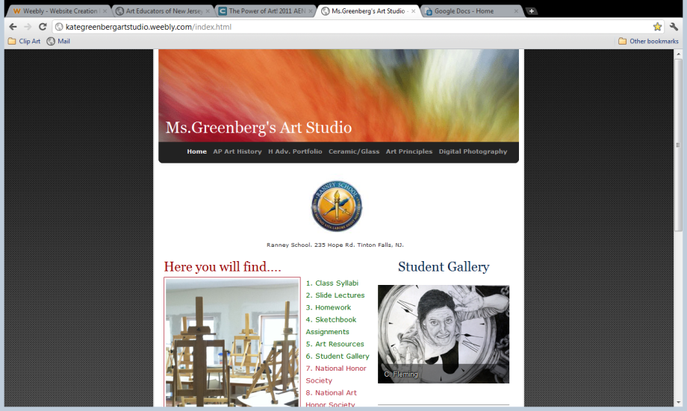
The Power of Public Art a model for teaching
AENJ Conference 2011
Kate Greenberg
Kategreenbergartstudio.weebly.com

