Slide 1
Mediterranean Art Part II
Chapters 5 and 6
Greek and Roman Art

Slide 2
Essential Questions for Greek Art
How did works of art and architecture function in Greece?
What styles developed to portray deities and human figures?
How did these forms reflect Greek values and culture? Make connections between a culture, it’s political structure and religious beliefs and the stylistic characteristics of the art made during this time. For example: How are the values of idealism, rationalism and humanism expressed in Greek art and architecture?
What techniques are developed to identify important historical figures or events?
How is power and authority expressed in art and architecture?

Slide 3
Periods in Greek art
Archaic:
Lasting from 700 BC to 480 BC, its end coincides with Greek, especially Athenian, dominance of the Aegean region following the defeat of the Persians.
Classical Greek Art
Early Classical: 480-450 BCE
High Classical: 450-400 BCE
Late Classical: 400-323 BCE
Hellenistic:
the Hellenistic Period is usually accepted to begin in 323 BC with Alexander's death and ends in 31 BC with the conquest of the last Hellenistic kingdom by Rome, the Lagid kingdom of Egypt.
Characterized by 3 general ideas:
Humanism (Man is the measure of all things)
Rationalism (Reason should dominate over emotion)
Idealism (Perfection is sought)
Characterized by an expanded and diverse population art becomes more dramatic, poses have more movement and subjects are expanded to include everyday people.

Slide 4
Athenian agora, Archaic through Hellenistic, Greek,. 600 BCE-150 CE
Plan.

Slide 5
Anavysos Kouros. Archaic Greek. 530 BCE. Marble with remnants of paint.
Click on image for video

Slide 6
Peplos Kore from the Acropolis. Archaic Greek. 530 BCE Marble, painted details.
Click on image for video

Slide 7
Greek Vases

Slide 8
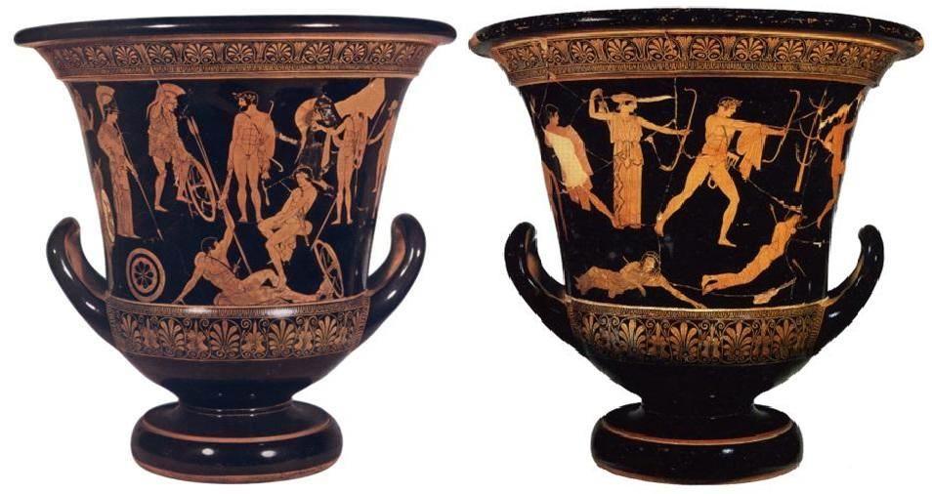
Niobides Karater. Anonymous vase painter of Classical Greece known as the Niobid painter. 460-450 BCE, Clay, red figure with white highlights
Click on image for video on how pottery was made

Slide 9
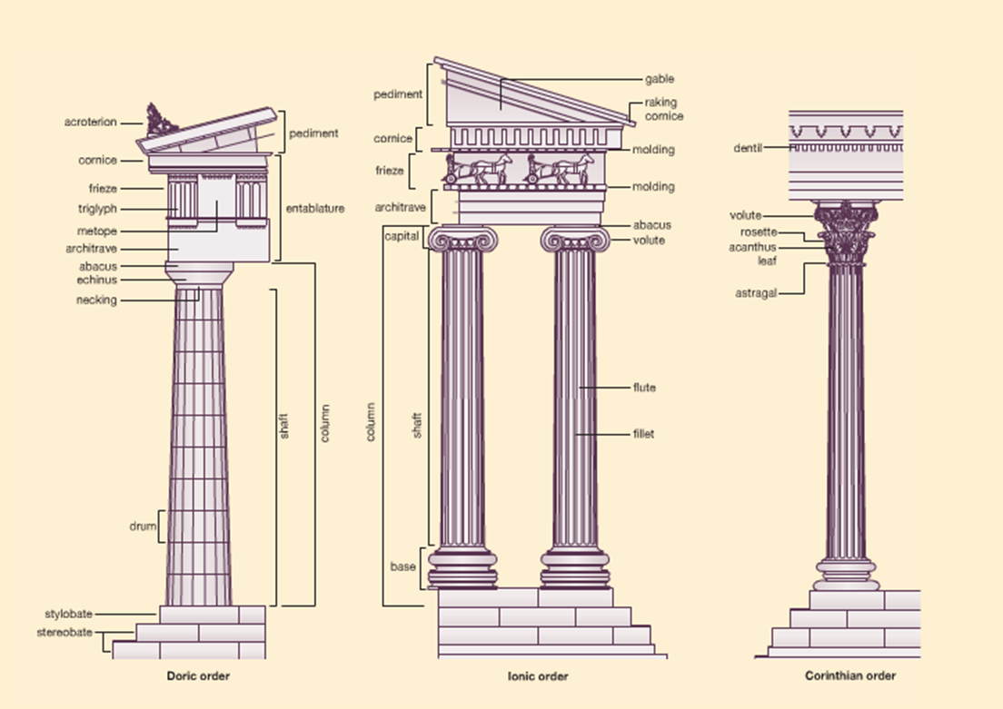
Greek architectural orders

Slide 10
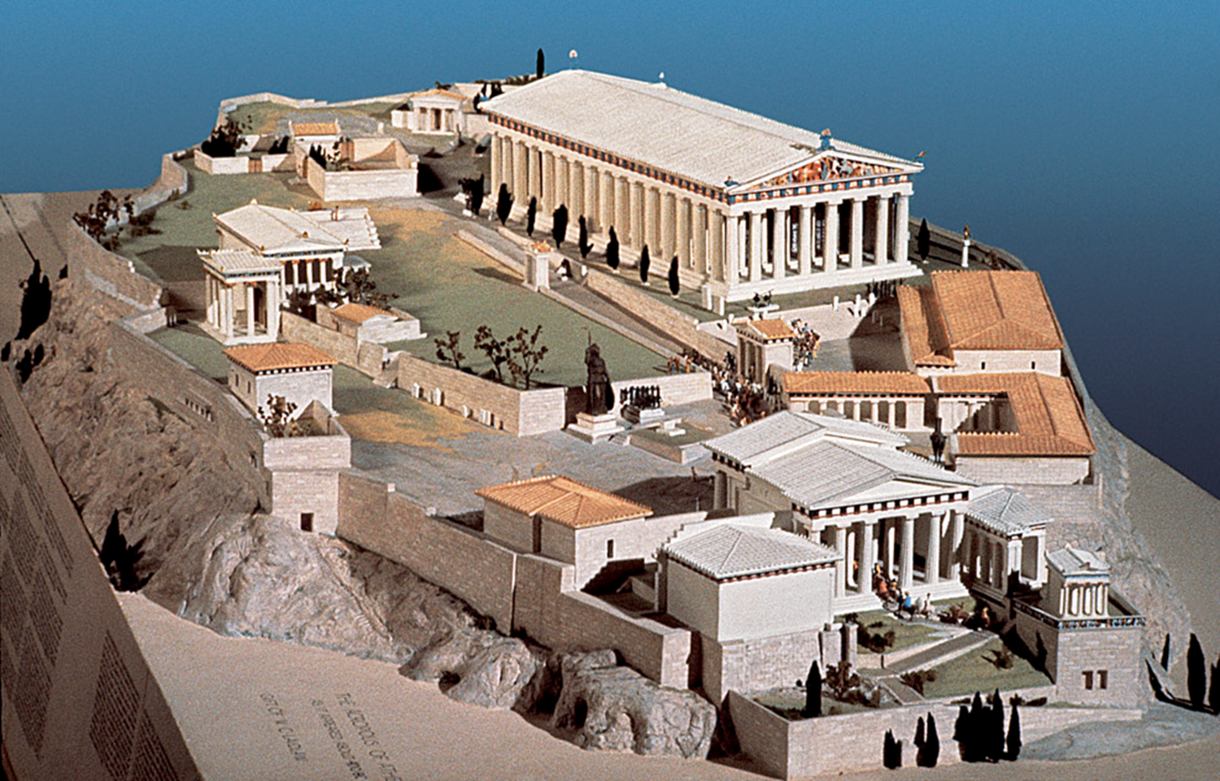
Kallikrates and Iktinos
Title: Parthenon, Acropolis, Athens. View from the Northwest.
Medium: Pantelic marble
Size: n/a
Date: 447–432 BCE

Slide 11
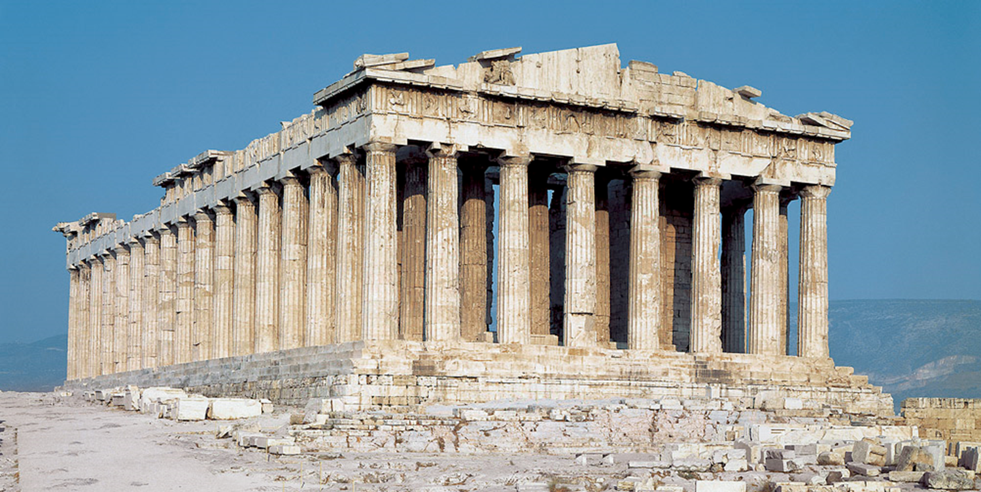
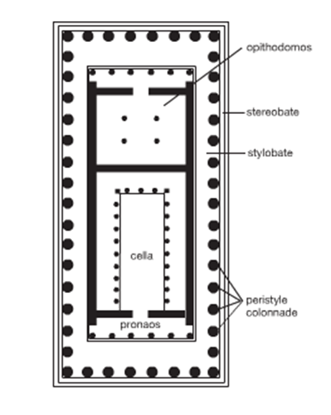
Click on image for video
Treasury and temple

Slide 12
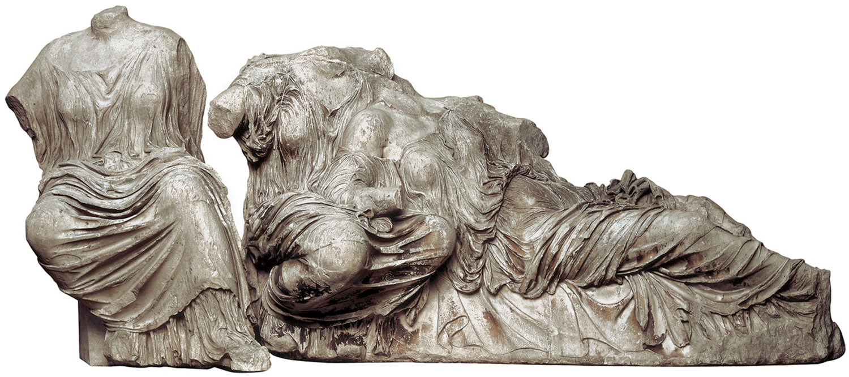
Click on image for video

Slide 13
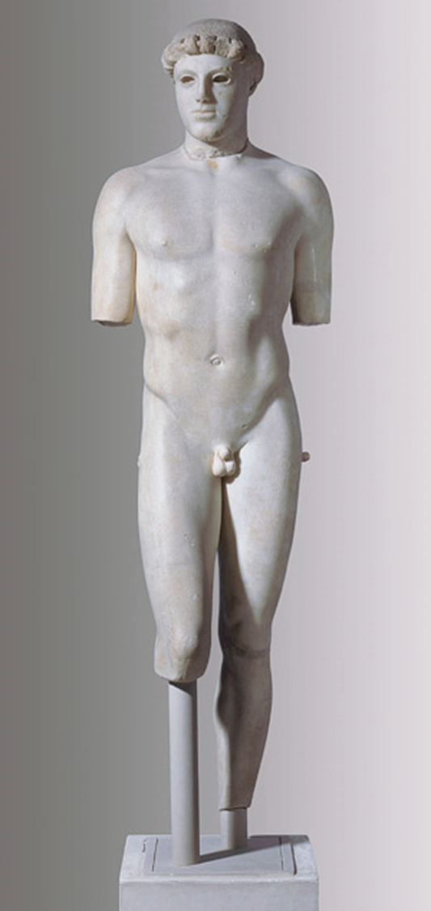
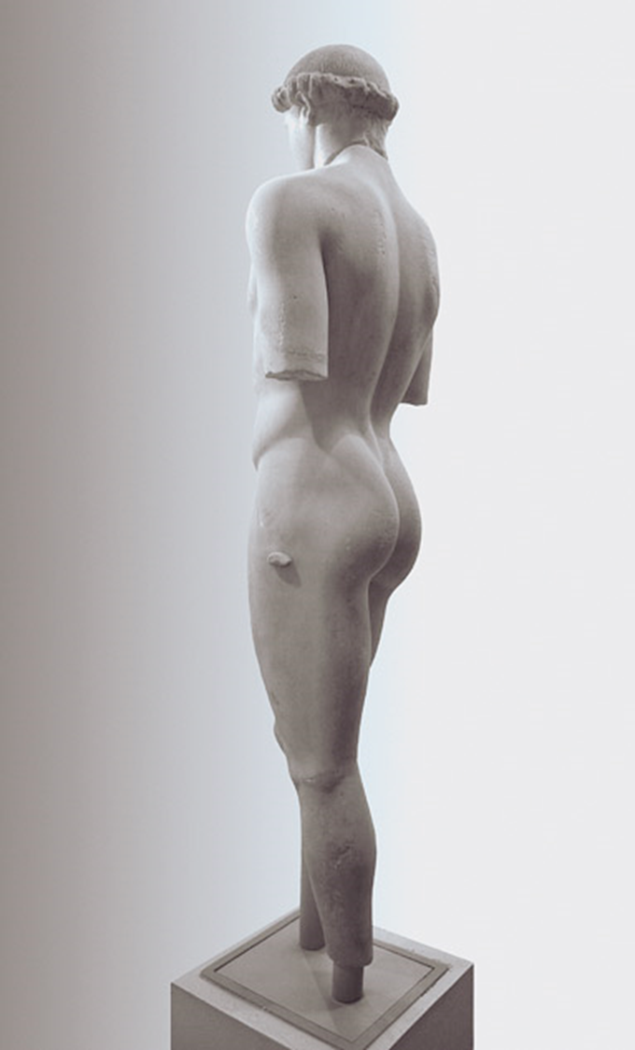
Kritian Boy
Medium: Marble
Size: height 3'10" (1.17 m)
Date: c. 480 BCE
Source/Museum: From Acropolis, Athens / Acropolis Museum, Athens

Slide 14
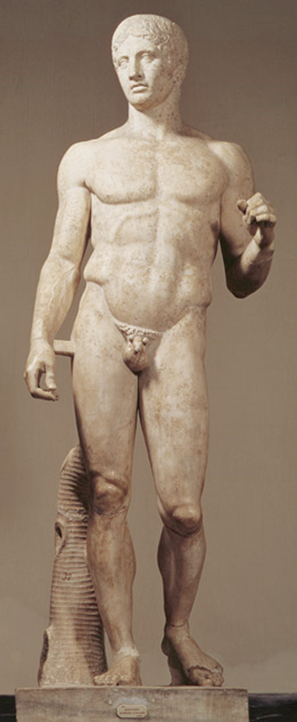
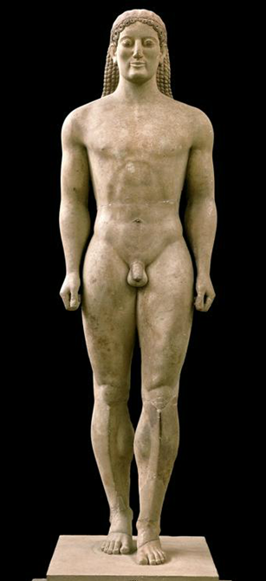
Spear Bearer (Doryphoros), also known as Achilles
Medium: Marble (tree trunk and brace strut are Roman additions)
Size: height 6'11" (2.12 m)
Date: Roman copy after the original bronze of c. 450–440 BCE
High Classical
Anavysos Kouros, Archaic

Slide 15
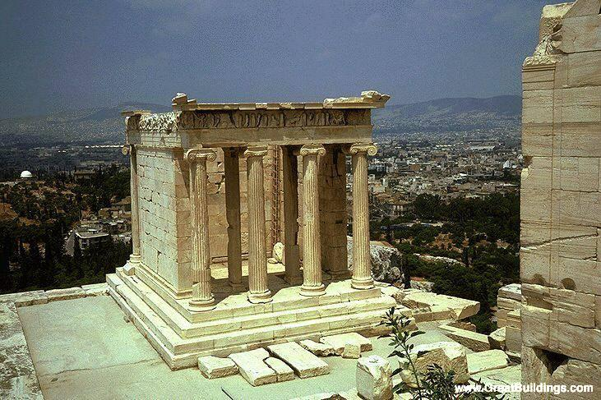
Temple of Athena Nike, Marble, 420 BCE.
Notes:
The southwest of the Acropolis plateau, right next to the Propylaia, has been an important location of a sanctuary dating back to the Mycenaean era. It is a protruding tall mass of rock, strategically located in a way that protects the south flank of the most vulnerable access point and gate to the citadel.
Early in its history it was a place of worship for deities associated with wars, perhaps Bronze Age “Nike” gods or goddesses, which with time fused with the cult of Athena Nike of later centuries. Excavations have revealed that on this location an open pit existed that Bronze Age Greeks used to pour libations and to deposit primitive figurines of the deities worshiped.
During the Archaic era a small temple stood on the site that faced an altar to its east. This building was destroyed by the Persians in 480 BCE along with the rest of the Acropolis, and was not rebuilt until 435 BCE.
The Classical temple that has survived was completed in 420 BCE.

Slide 16
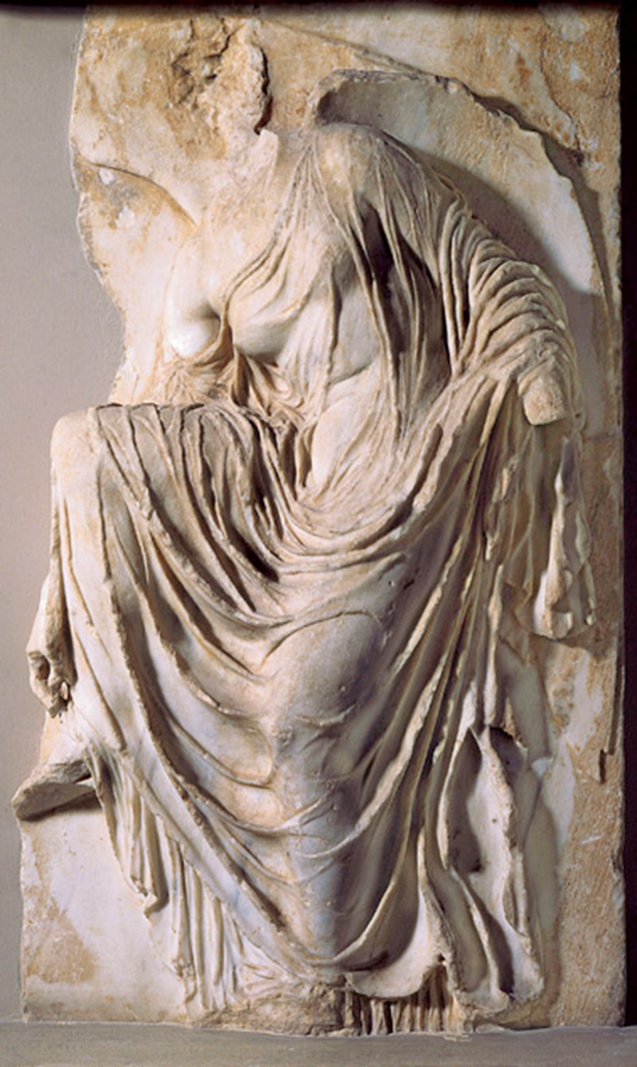
Nike (Victory) Adjusting Her Sandal
Medium: Marble
Size: height 3' 6" (1.06 m)
Date: Last quarter of the 5th century (perhaps 410–405) BCE
Source/Museum: Fragment of relief decoration from the parapet (now destroyed), Temple of Athena Nike, Acropolis, Athens / Acropolis Museum, Athens
Click on image for video

Slide 17
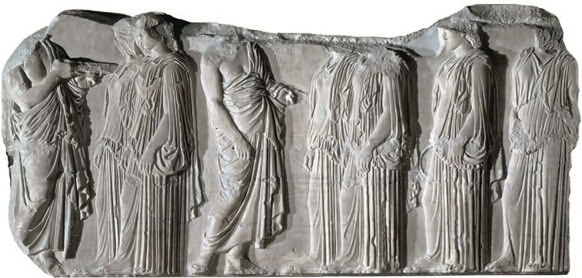
This sculpted plaque is a perfect example of Classical Greek art from the frieze decorating the exterior of the Parthenon temple, built between 447 and 432 BC to glorify Athens and its divine protector, Athena. It shows one of the high points of the Great Panathenaea festival held every four years in Athens. Here, six Ergastines (young women in charge of weaving the peplos overgarment offered to Athena) are greeted by two priests as they walk in procession towards the assembly of the gods.
Click on image for video
Notes:
This sculpted plaque is a perfect example of Classical Greek art from the frieze decorating the exterior of the Parthenon temple, built between 447 and 432 BC to glorify Athens and its divine protector, Athena. It shows one of the high points of the Great Panathenaea festival held every four years in Athens. Here, six Ergastines (young women in charge of weaving the peplos overgarment offered to Athena) are greeted by two priests as they walk in procession towards the assembly of the gods.

Slide 18
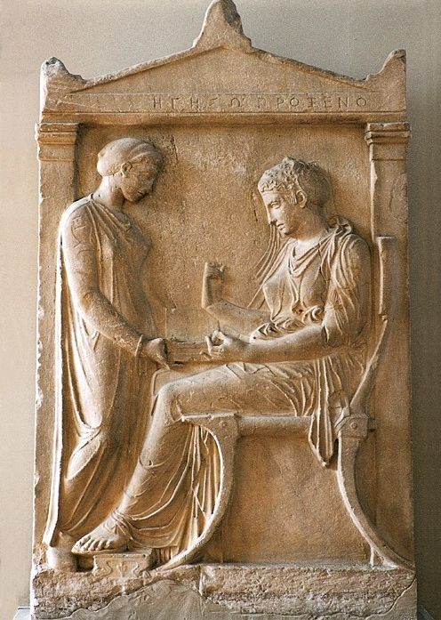
Title: Grave Stele of Hegeso
Medium: Marble
Size: height 5'2" (1.58 m)
Date: c. 410–400 BCE

Slide 19
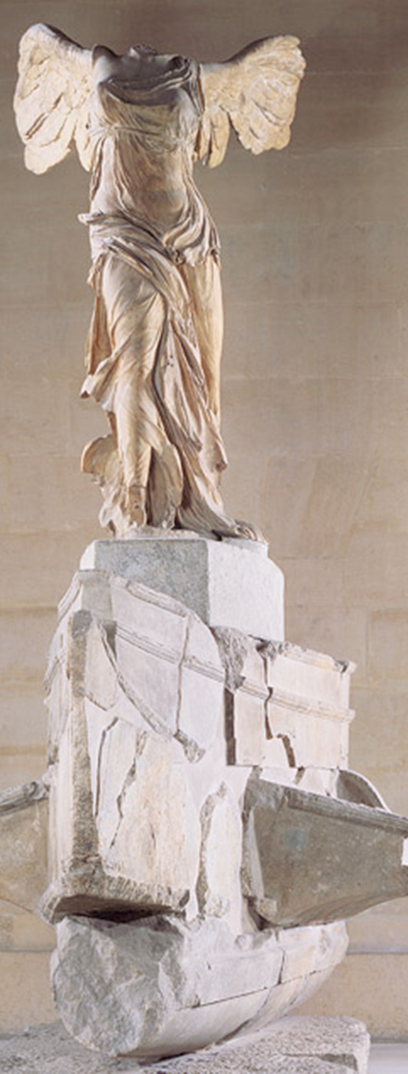
Title: Nike (Victory) of Samothrace
Medium: Marble
Size: height 8'1" (2.45 m)
Date: c. 180 BCE (?)

Slide 20
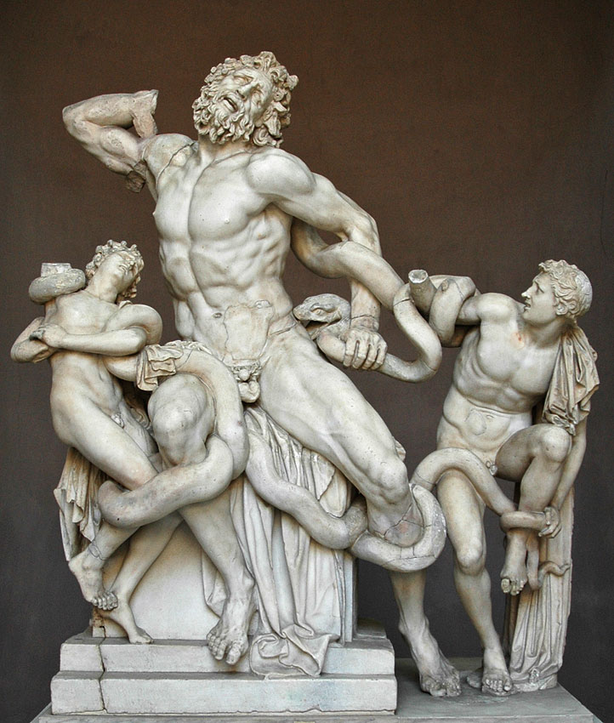

Slide 21
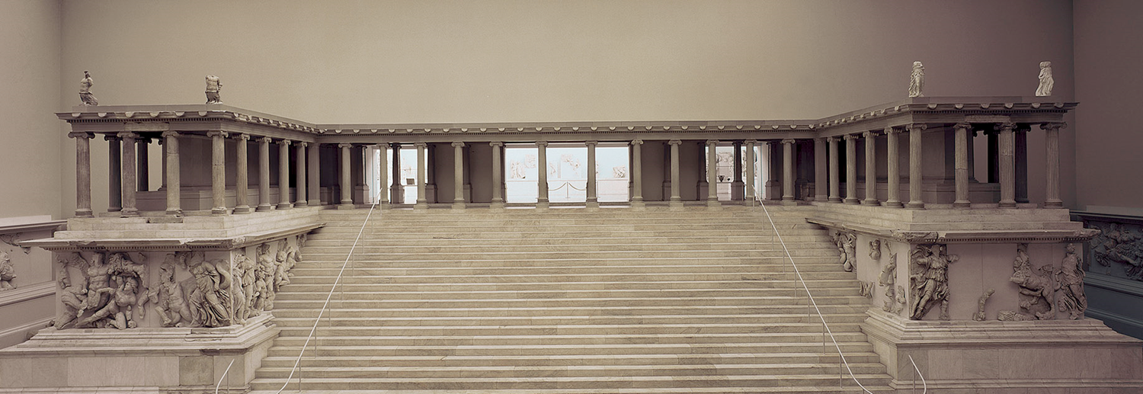
Title: Reconstructed west front of the altar from Pergamon, Turkey
Medium: Marble
Size: Height of figure 7'7" (2.3 m)
Date: c. 175–150 BCE

Slide 22
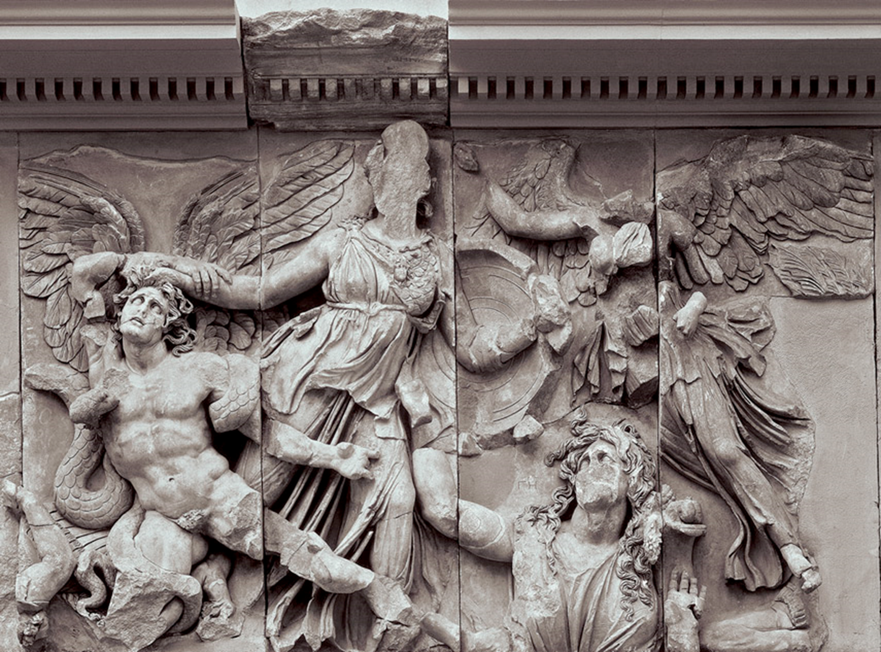
Title: Athena Attacking the Giants
Medium: Marble
Size: frieze height 7'7" (2.3 m)
Date: c. 175–150 BCE
Source/Museum: Detail of the frieze from the east front of the altar from Pergamon

Slide 23
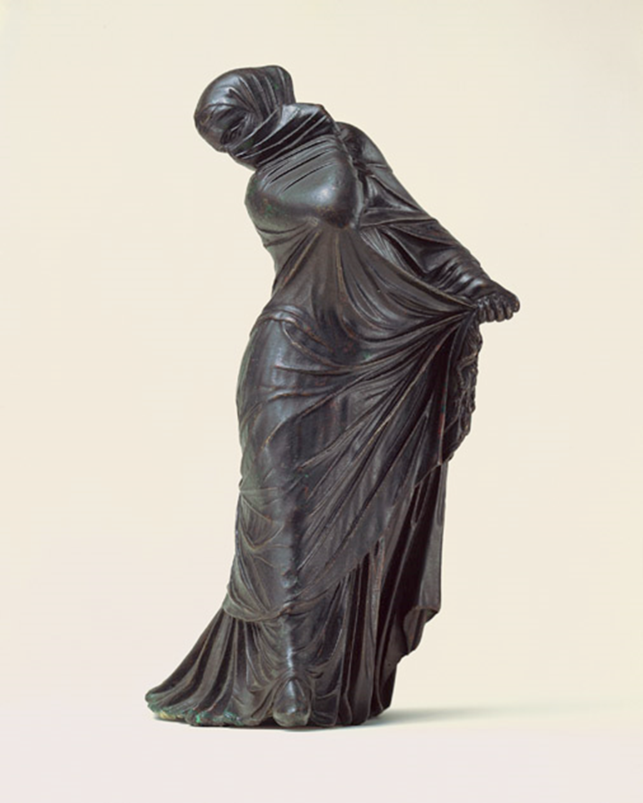
Title: Veiled and Masked Dancer
Medium: Bronze
Size: height 8 ⅛" (20.7 cm)
Date: Late 3rd or 2nd century BCE

Slide 24
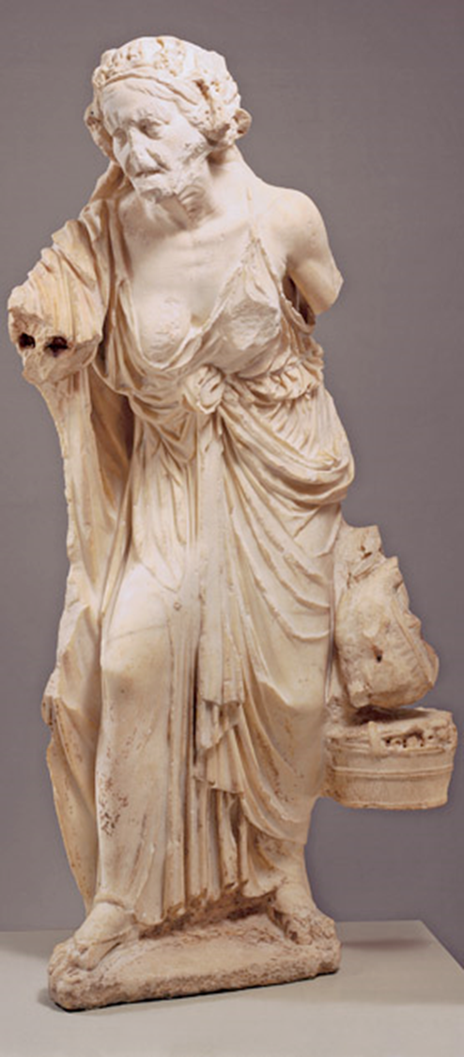
Title: Old Woman
Medium: Marble
Size: height 49½" (1.25 m)
Date: Roman copy, 1st century CE

Slide 25
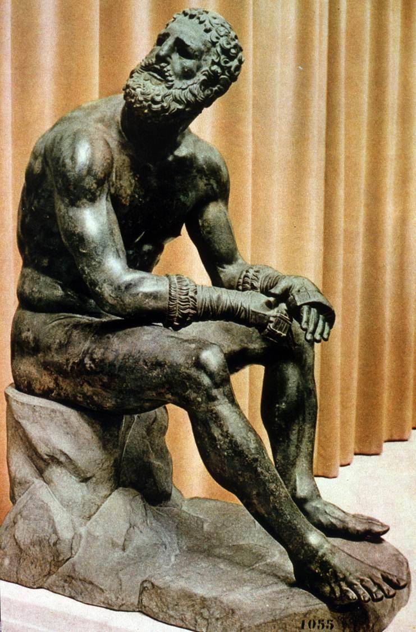
Title: Seated Boxer
Style: Hellenistic
Medium: Bronze
Size: Larger than Life size
Date: Roman copy, 100 BCE
Slick on image for video

Slide 26
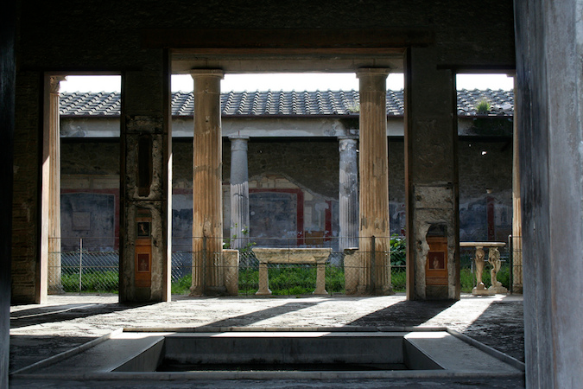
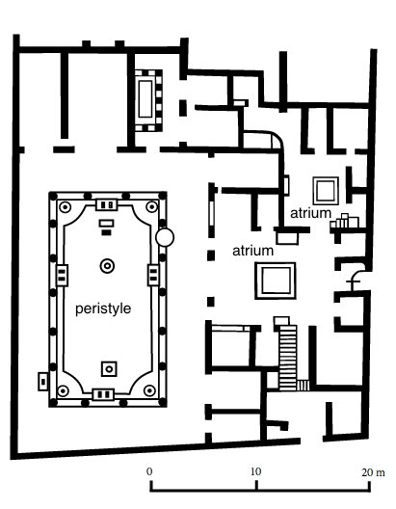
Title: House of Vetti, Pompeii, Italy
Style: Imperial Roman
Medium: Bronze
Date: 2nd century BCE

Slide 27
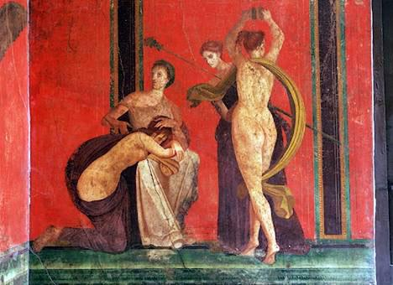
Title: House of Vetti, Pompeii, Italy
Style: Imperial Roman
Medium: Frescoe
Date: 2nd century BCE

Slide 28
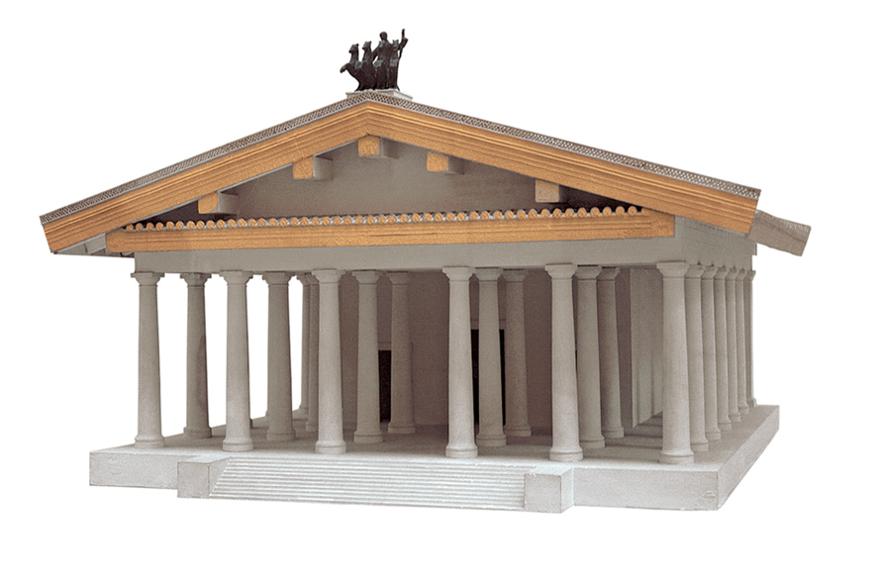
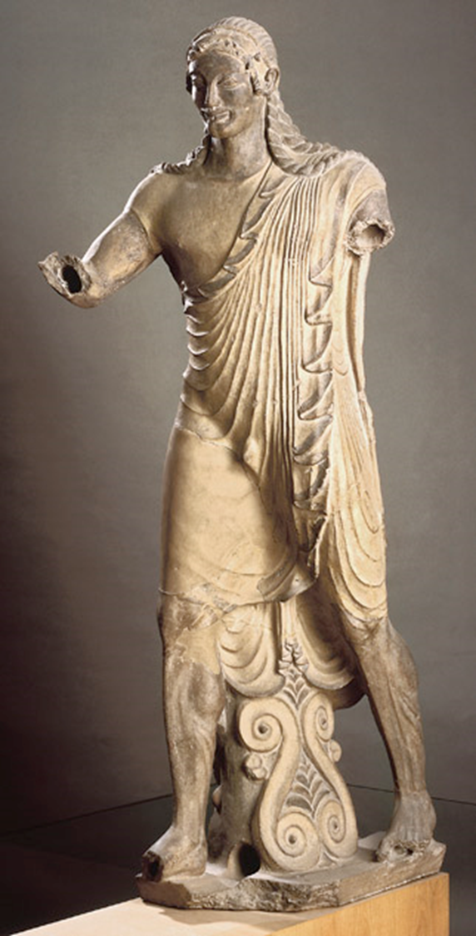
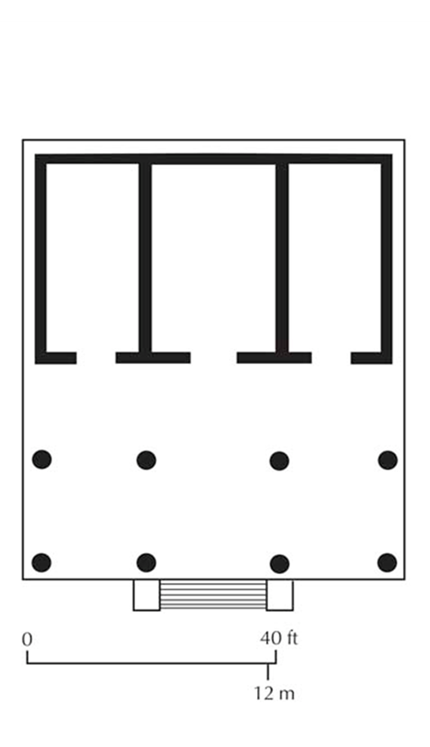
Title: Apollo
Style: Etruscan
Medium: Terra Cotta
Date: 510-500 BCE
From the Temple of Minerva

Slide 29
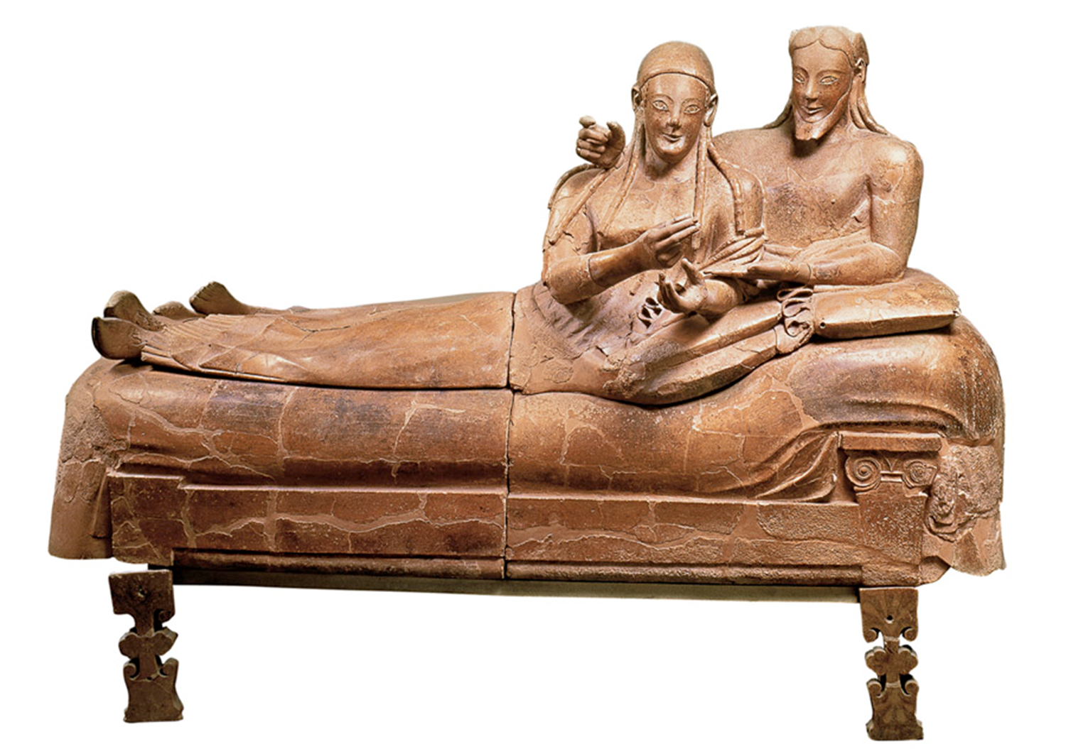
Title: Sarcophagus of the Spouses
Style: Etruscan
Medium: Terra Cotta
Date: 520 BCE
Click on image for video

Slide 30
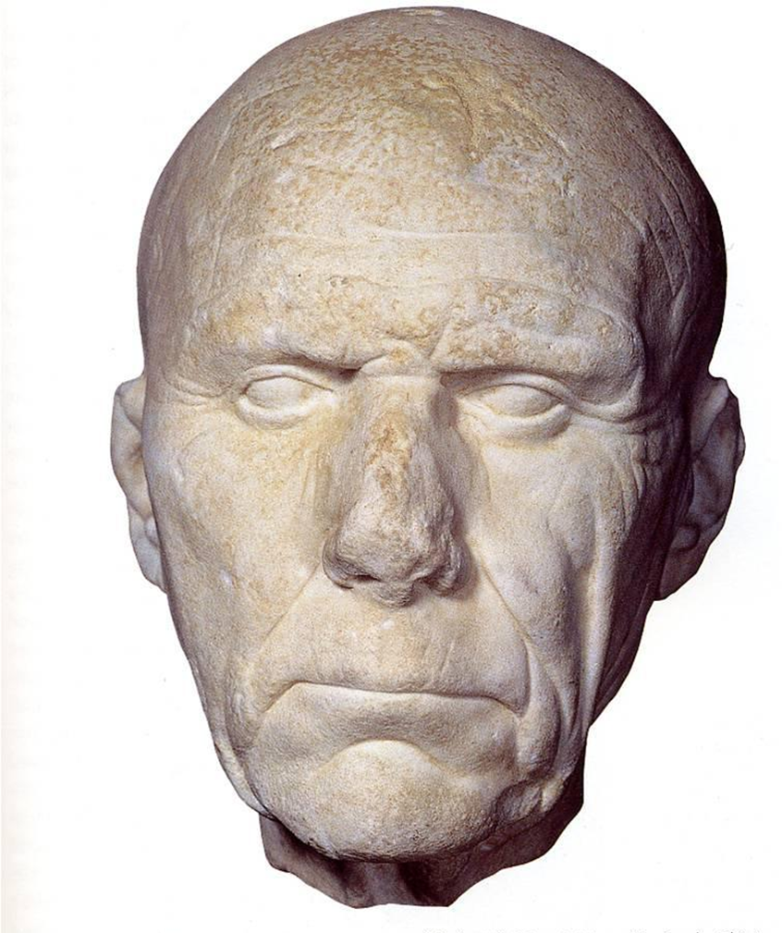
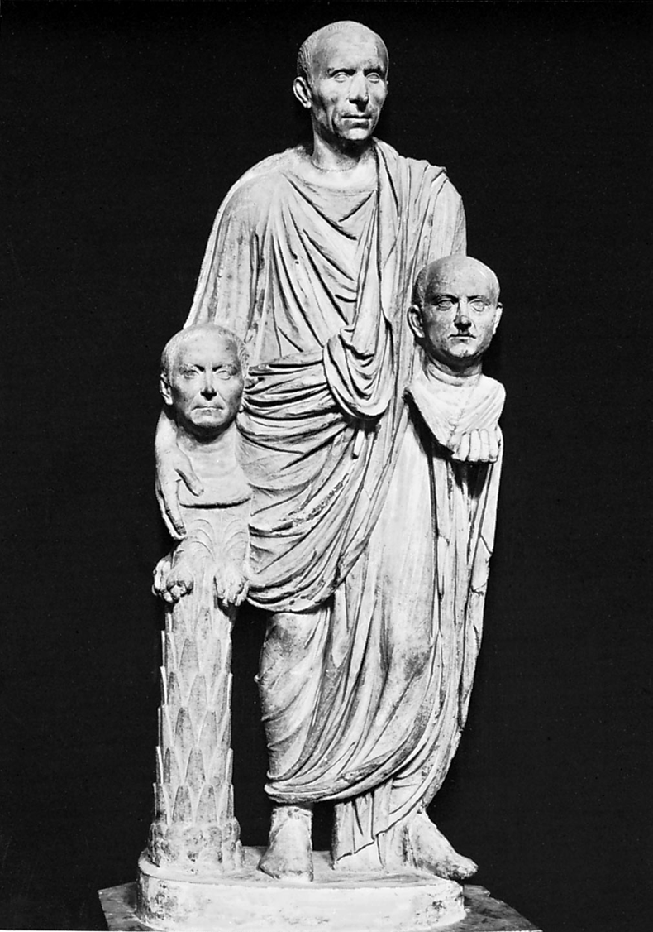
Title: Bust of Roman Patrician
Style: Roman Republic
Medium: Marble
Date:

Slide 31
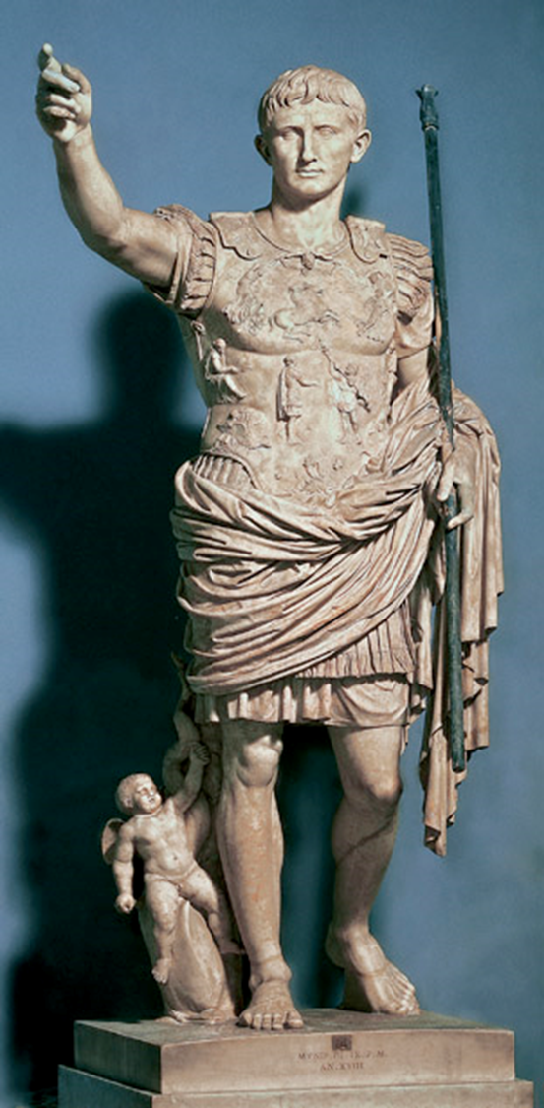
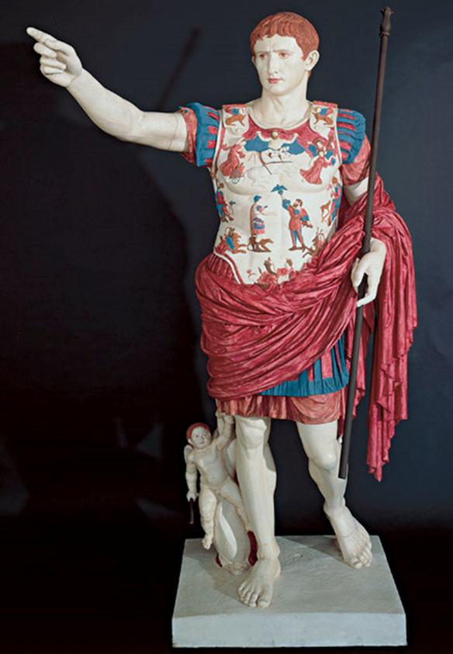
Title: Augustus of Prima Porta
Style: Roman Empire
Medium: Painted Marble
Date: first century CE

Slide 32
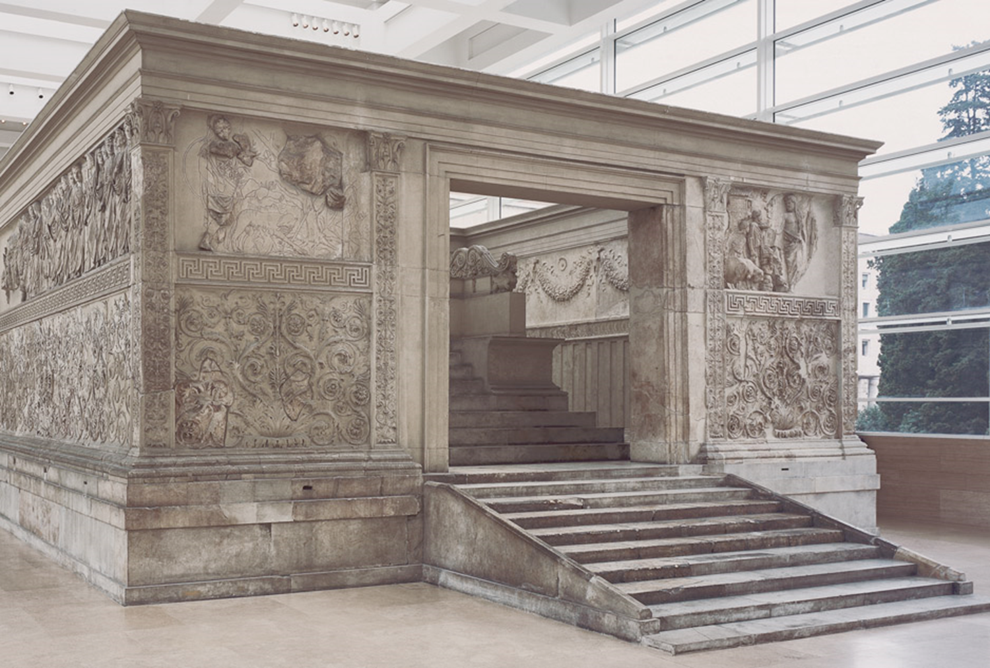
Title: Ara Pacis Augustae (altar of Augustan Peace)
Style: Roman Empire
Medium: Marble
Date: first century13-9 CE

Slide 33
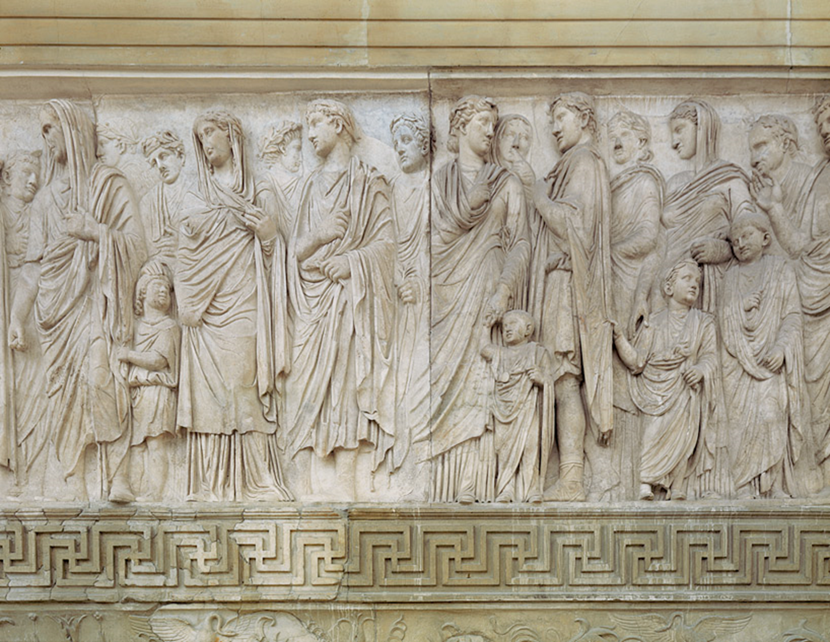
Title: Ara Pacis Augustae (altar of Augustan Peace)
Style: Roman Empire
Medium: Marble
Date: first century13-9 CE

Slide 34
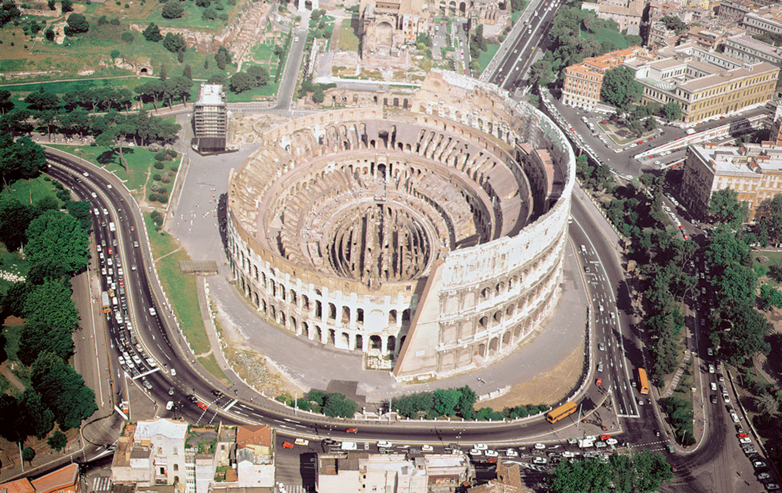
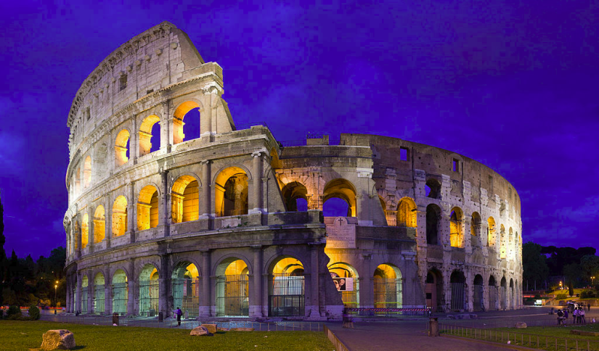
Title: Colosseum, Flavian Amphitheater
Style: Roman Empire
Medium: Marble
Date: 70-80 CE

Slide 35
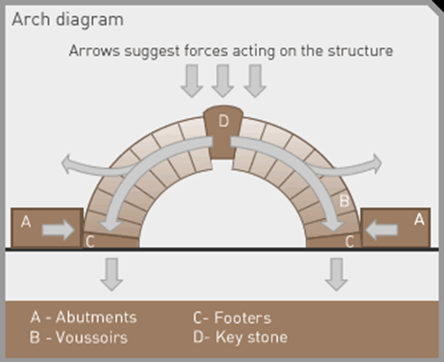
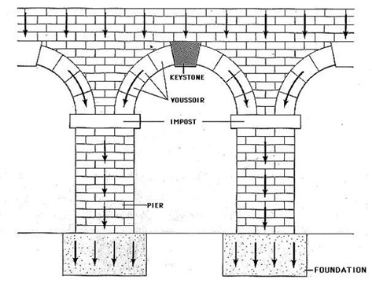
Title: Roman Engineering

Slide 36
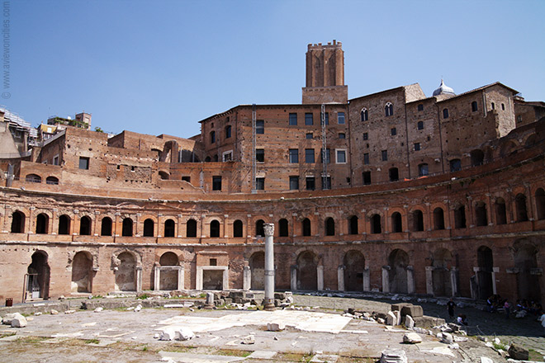
Trajan's Market is a large complex of ruins in the city of Rome, Italy, located on the Via dei Fori Imperiali, at the opposite end to the Colosseum.

Slide 37
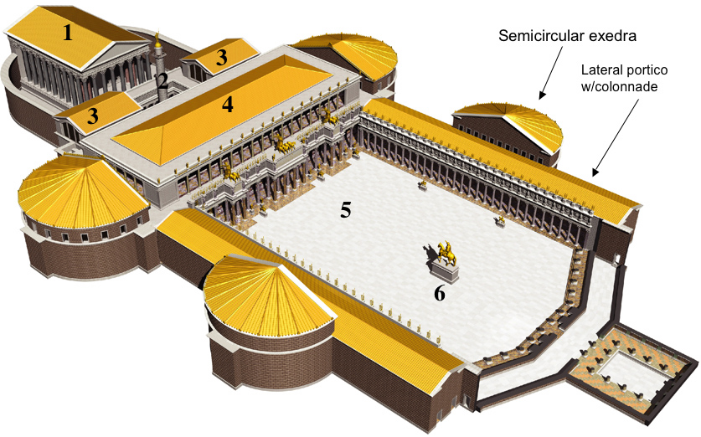
Forum of Trajan Reconstruction

Slide 38
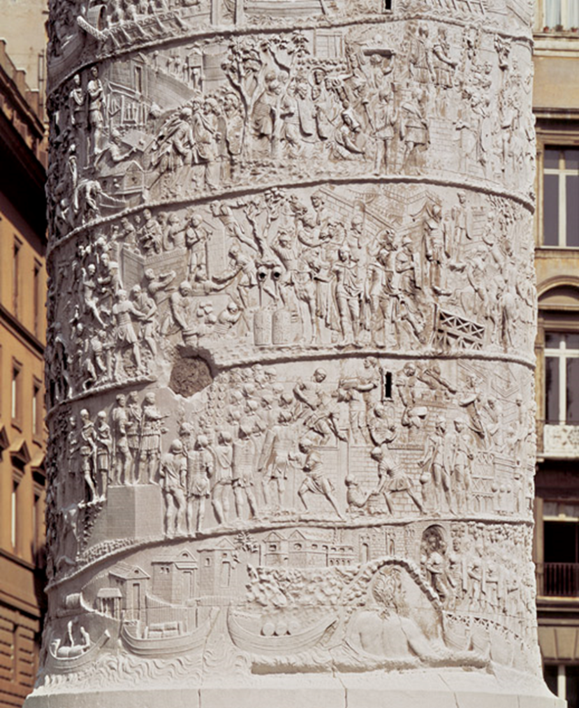
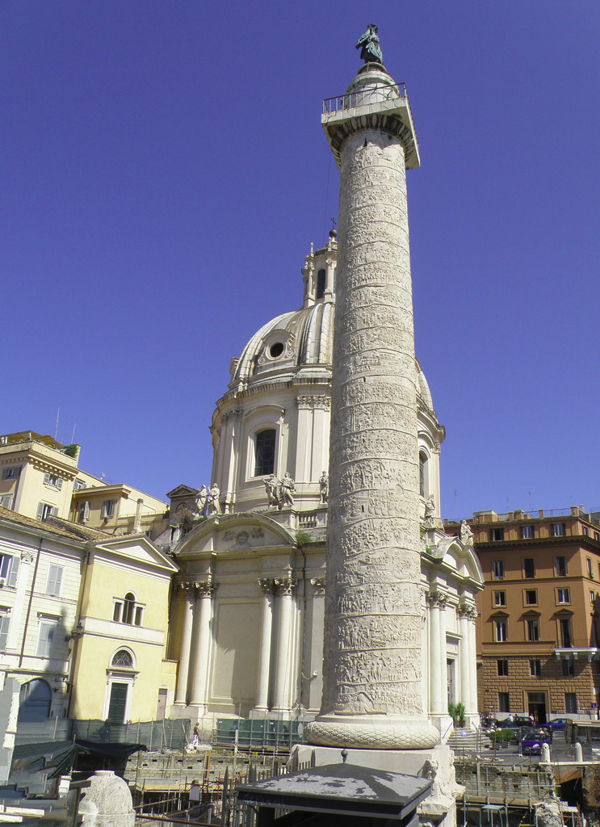
Click on image detail for video
Title: Romans Crossing The Danube and Building A Fort
Medium: Marble
Size: height of the spiral band approx. 36" (91 cm)
Date: 113–16 or after 117 CE

Slide 39
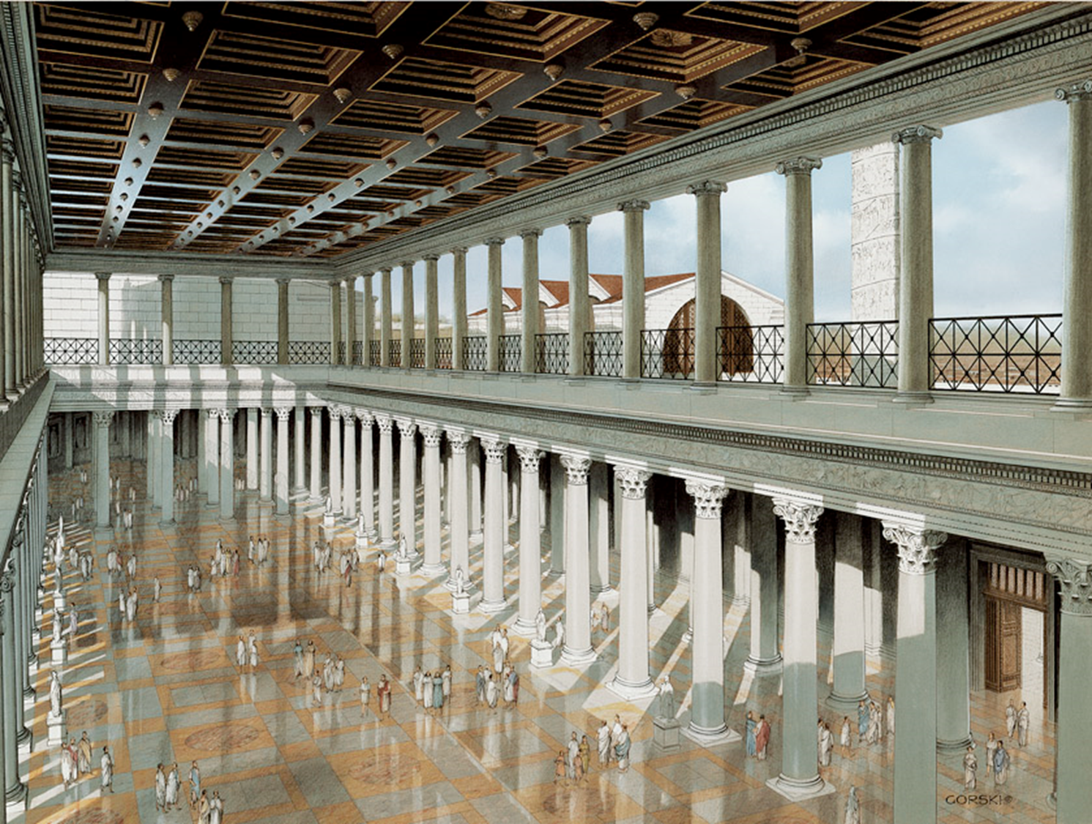
Artist: Drawn by Gilbert Gorski.Trajan’s architect was Apollodorus of Damascus
Title: Restored perspective view of the central hall, Basilica Ulpia, Rome
Medium: n/a
Size: n/a
Date: c. 112 CE
Source/Museum: n/a

Slide 40
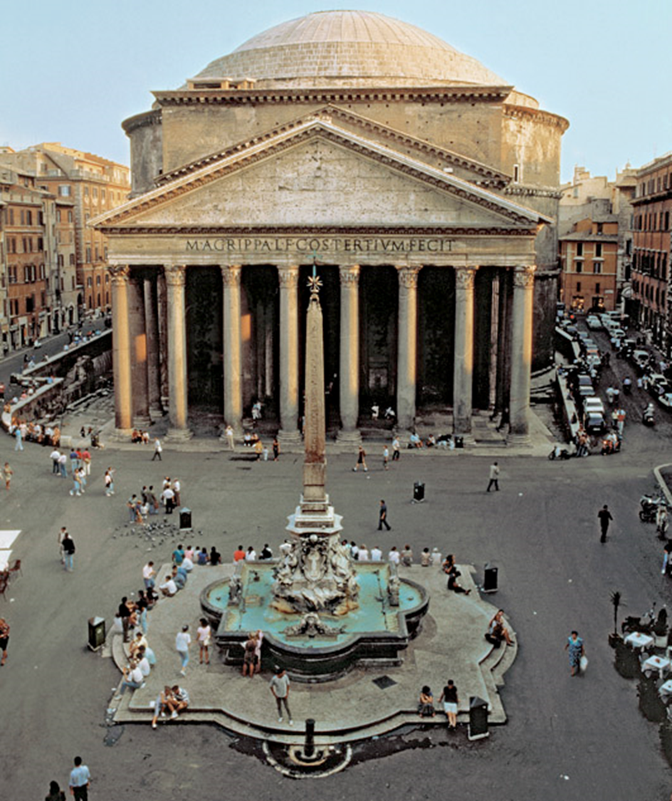
Title: Pantheon
Medium: n/a
Size: n/a
Date: c. 118–128 CE

Slide 41
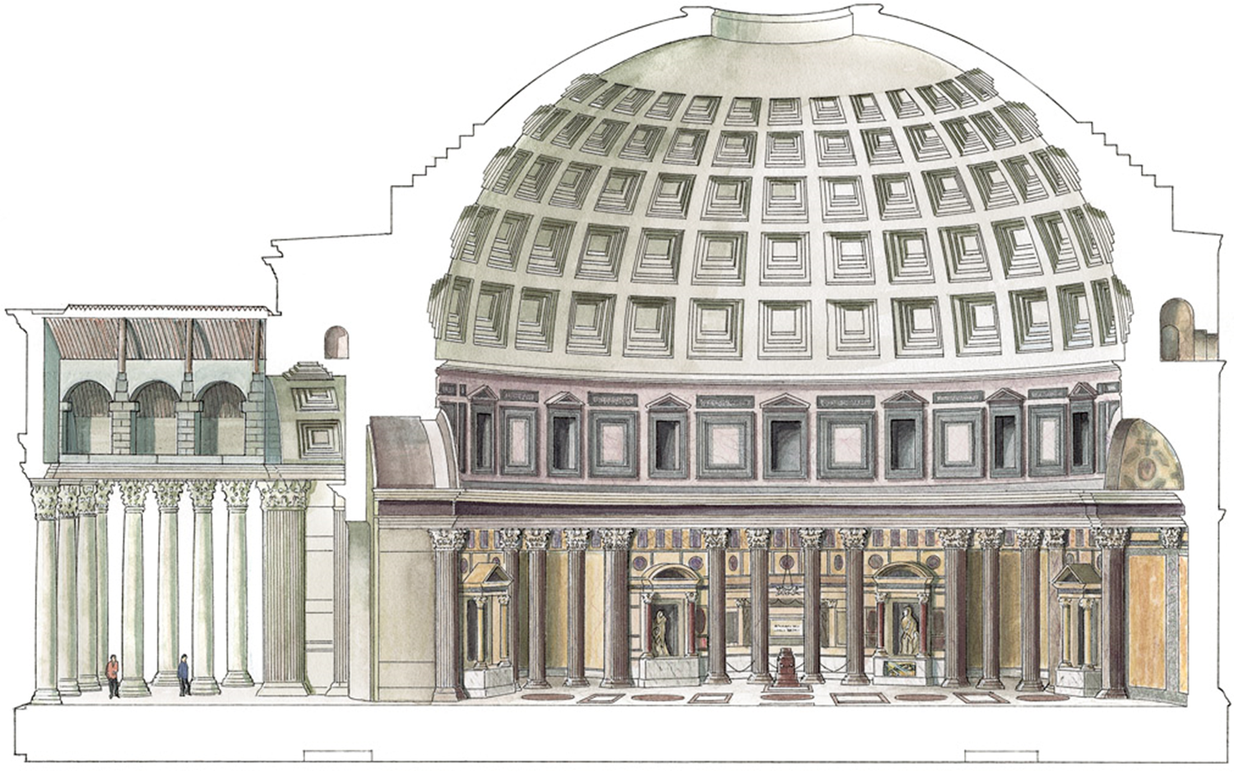
https://www.khanacademy.org/test-prep/ap-art-history/ancient-mediterranean-AP/ap-ancient-rome/v/the-pantheon-rome-c-125
Click on image for video

Slide 42
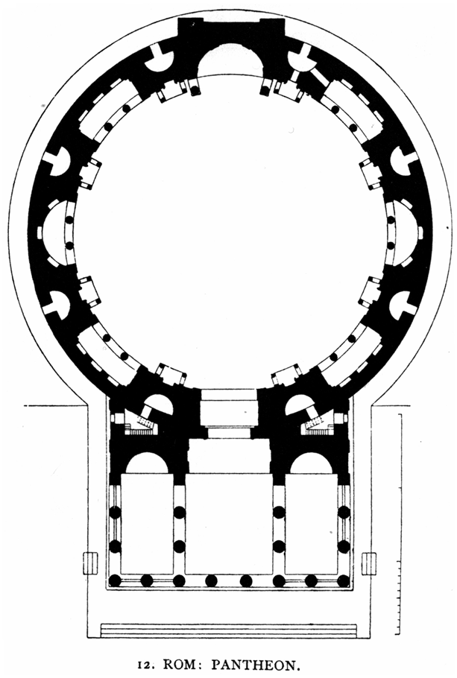
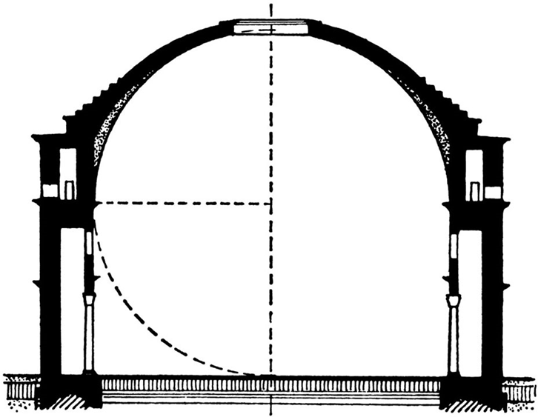

Slide 43
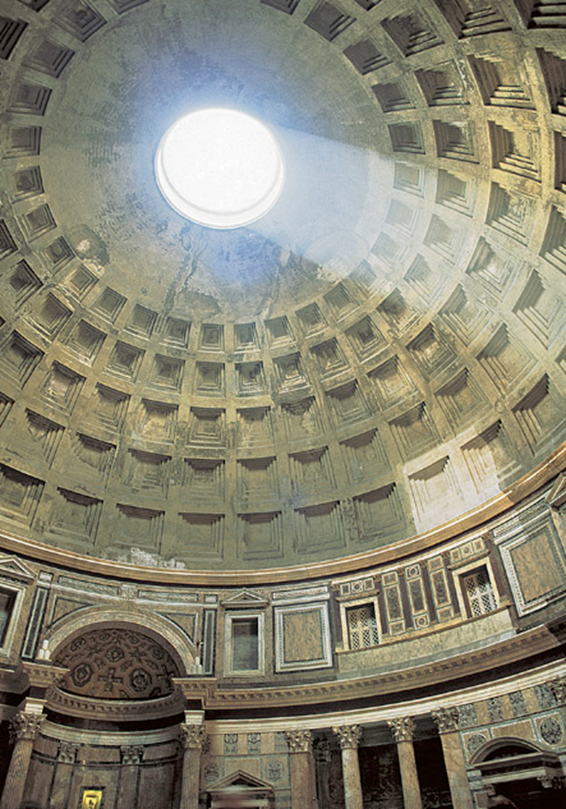
Title: Dome of the Pantheon with light from the oculus on its coffered ceiling
Medium: Brick, concrete, marble, veneer
Size: diameter of dome 143' (43.5 m)
Date: 125–128 CE
Source/Museum: Rome

Slide 44
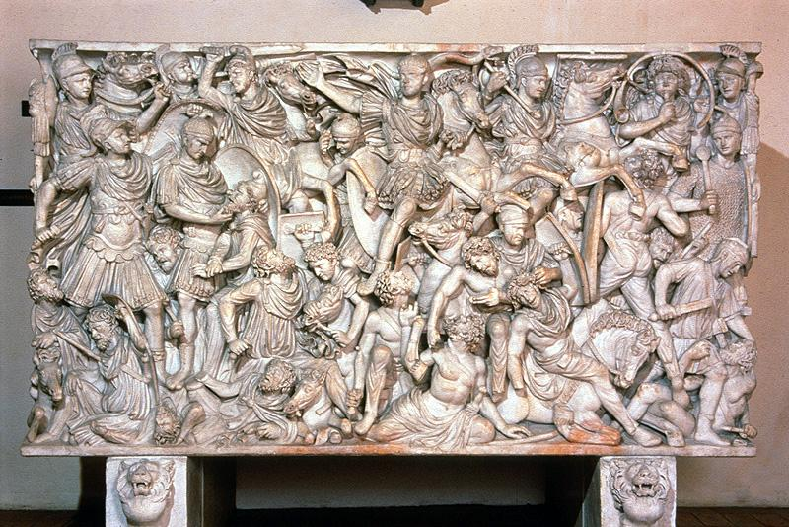
Title: :Ludovisi Battle Sarcophagus
Medium: marble
Late Imperial
Date: 250 CE
Click on image for video

Slide 45
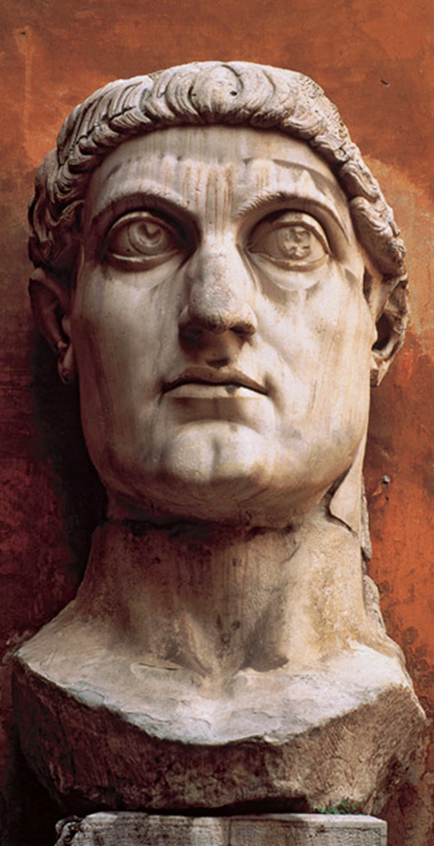
Title: Constantine The Great
Medium: Marble
Size: height of head 8'6" (2.6 m)
Date: 325–26 CE
Source/Museum: Basilica of Maxentius and Constantine, Rome / Palazzo dei Conservatori, Rome

